Slide 1

Somerset School Health and Wellbeing
Survey 2023: Topic Report

Slide 2
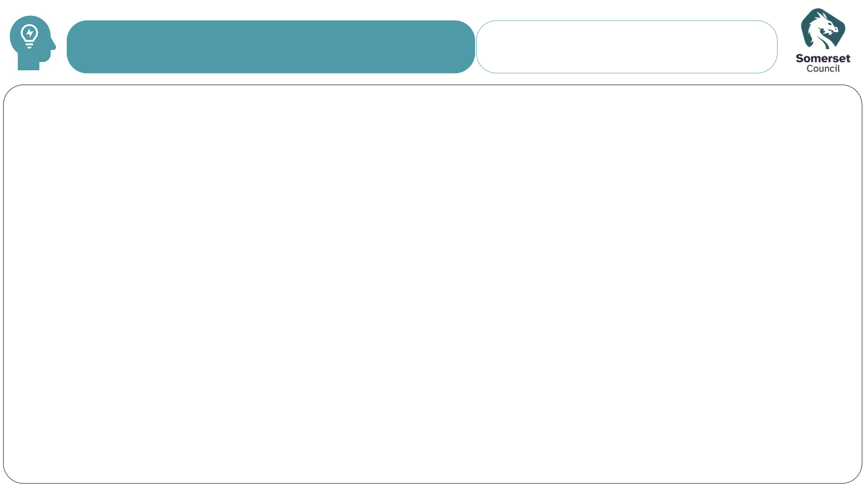
Somerset School Health and Wellbeing Survey 2023 - Topic Reports
Introduction
The Somerset School Health and Wellbeing Survey was formed of three age-appropriate questionnaires covering Key Stage 1 (KS1), Primary School and Secondary School. The KS1 survey was undertaken by children in year 2, the Primary by children in Year 4 and Year 6, and the secondary by those in year 8 and year 10. Limiting it to these age groups gives a consistent picture of the health and wellbeing in schools and recognises the demand on pupils and schools' resources and time.
Schools taking part were given the option of giving their children in other year groups the opportunity to take part. These results are excluded from this topic report so that a fair comparison can be made with the overall Somerset responses. The responses from the non-core year groups are outside the scope of the main reporting.
All proportions in this report are calculated using the total respondents for each version of the survey or year group unless explicitly stated otherwise.
If you have any questions about the survey or would like to provide feedback, please contact schoolsurvey@somerset.gov.uk
Topic reports are designed to be read alongside the Somerset Schools Health and Wellbeing Survey data pack and Somerset key findings documents. The key messages contained within these documents provide schools and partners with a focus on which survey themes (e.g., bullying, sleep) are a priority to address. The reports are accessible online here: Somerset Schools Health and Wellbeing Survey Countywide Reports.
Topic reports look at an area of interest, usually a school, geographical area or a particular group of pupils (e.g., females in KS1 or pupils identifying as having a disability) and provides a complete summary of their responses. The report can be used to understand how the responses from the area of interest may have been different from the Somerset wide cohort.
The following page explains how to interpret a topic report.

Slide 3
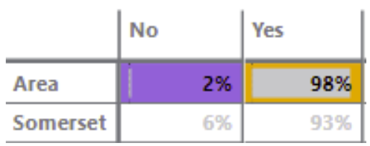
Somerset School Health and Wellbeing Survey 2023 - Topic Reports
Guide
The report shows the responses for the AREA OF INTEREST and how this compares with the overall response for all participating schools in Somerset.
The AREA OF INTEREST and the TOPIC OF INTEREST will be shown in the bottom left hand corner.
The AREA OF INTEREST represents the response(s) given and the TOPIC OF INTEREST represent the question. Together they form the 'Area' measure in each results table. In most cases the AREA OF INTEREST is a School, or demographic group (e.g., Girls, those who have received free school meals) and the TOPIC OF INTEREST is the questionnaire version (for example, Secondary).
Each chart will have a row or column that says 'Area' and one that says 'Somerset'. The 'Area' line will show the value of the selected AREA OF INTEREST while the 'Somerset' line will show the average for all responses across Somerset.
Each value for the 'Area' will have a grey bar visually indicating the size of the percentage. Percentages have all been rounded to the nearest whole number and therefore may not add up to exactly 100%.
The value for the 'Area' will be shaded purple if the value is significantly lower than for Somerset and orange if the value is
significantly higher than for Somerset. The comparison was done using Somerset as a benchmark and 95% confidence
intervals using the Wilson Score method for proportions as recommended by Office of Health Improvement and Disparities (OHID): Technical Guidance - PHE
You can use the orange and purple highlighting to identify where your AREA OF INTEREST differs from the Somerset average and therefore may be an area for learning and/or action.
Please note the proportions highlighted in orange are higher.
This does not necessarily mean better.
Please note the proportions highlighted in purple are lower.
This does not necessarily mean worse.
You will need to use your own interpretation to assess if a value is better or worse or if the differences shown are simply different without necessarily being better or worse at all.

Slide 4
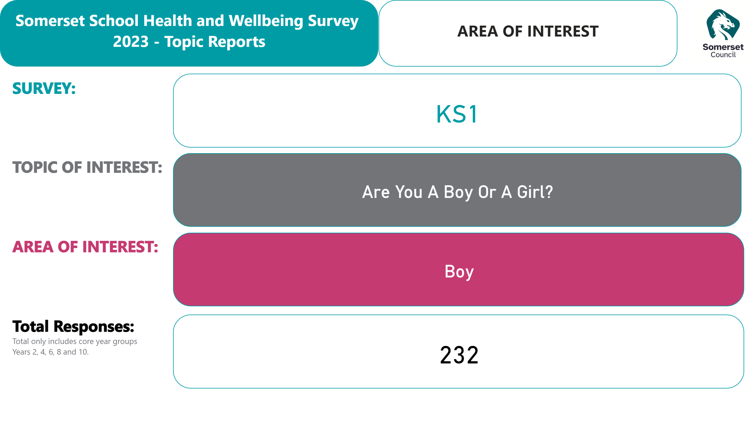
Selection
Notes:
Responses
No alt text provided
Responses
No alt text provided
Responses
No alt text provided
Responses
No alt text provided
textbox
No alt text provided
textbox
No alt text provided
textbox
No alt text provided
textbox
No alt text provided
textbox
No alt text provided
textbox
No alt text provided
image
No alt text provided

Slide 5
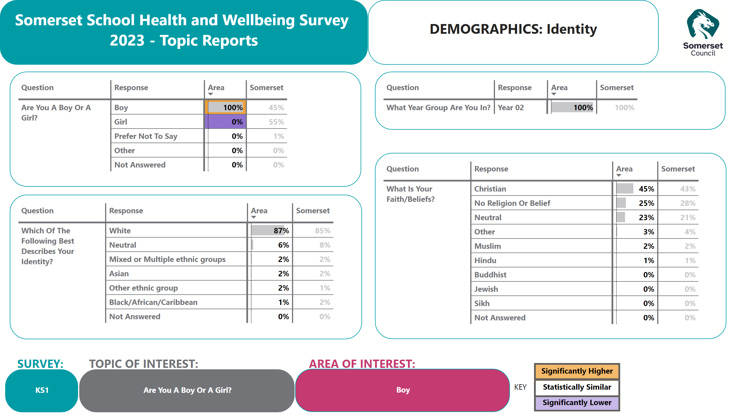
Demographics: Identity
Notes:
pivotTable
No alt text provided
textbox
No alt text provided
Text box 2023
No alt text provided
pivotTable
No alt text provided
pivotTable
No alt text provided
Responses
No alt text provided
actionButton
No alt text provided
Responses
No alt text provided
actionButton
No alt text provided
Responses
No alt text provided
actionButton
No alt text provided
actionButton
No alt text provided
actionButton
No alt text provided
actionButton
No alt text provided
actionButton
No alt text provided
pivotTable
No alt text provided
image
No alt text provided

Slide 6
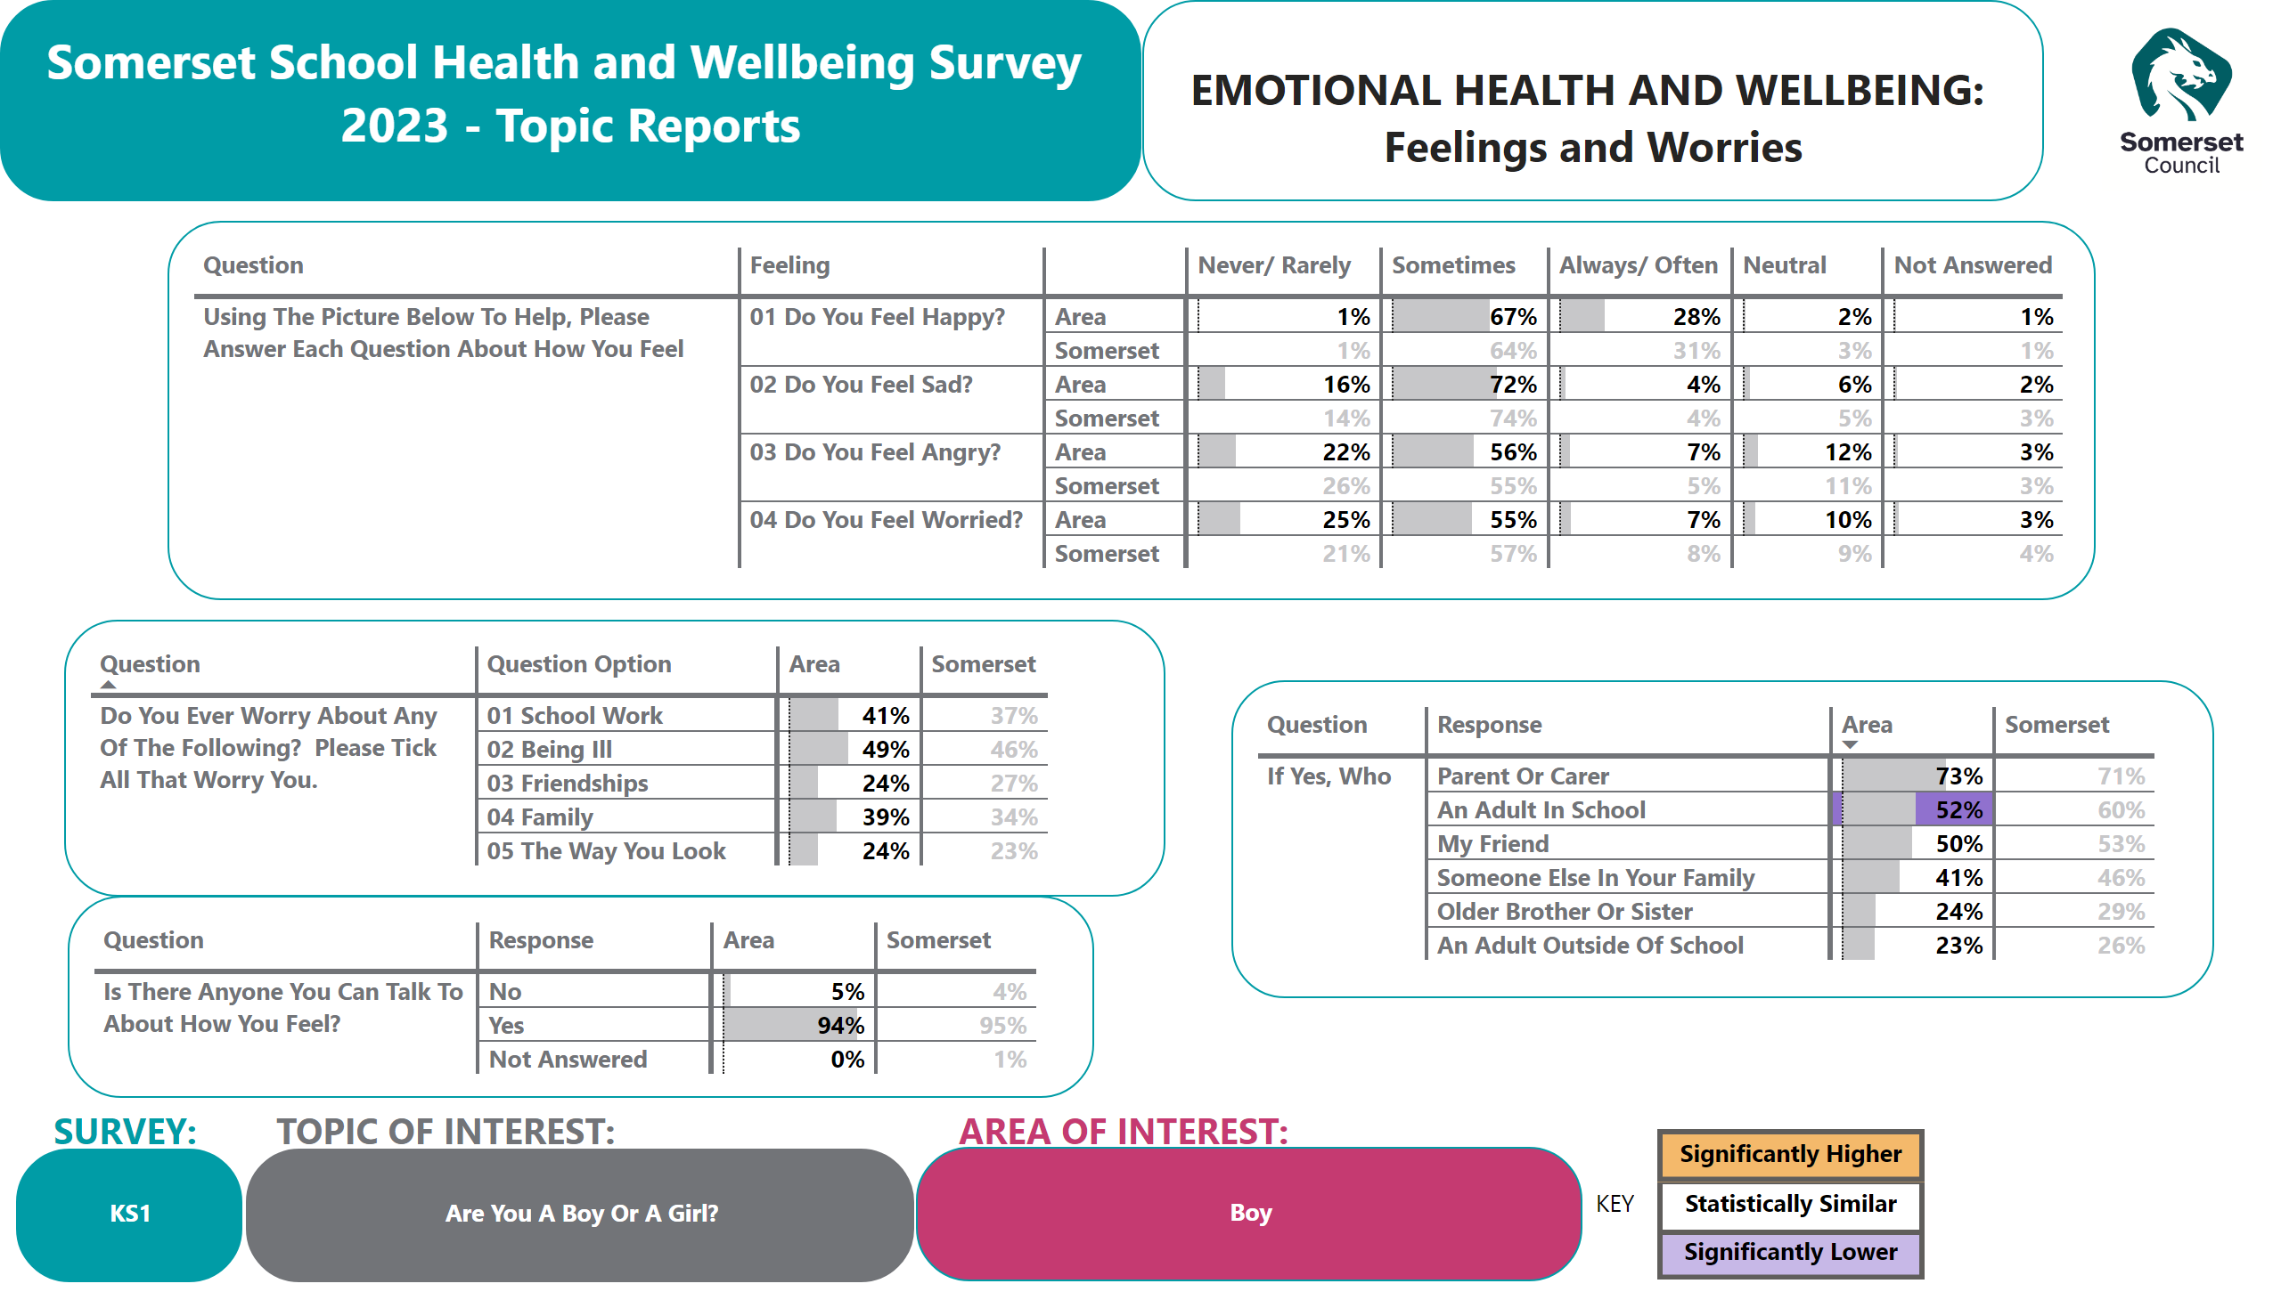
EHWB: Feelings and Worries
Notes:
Responses
No alt text provided
actionButton
No alt text provided
actionButton
No alt text provided
image
No alt text provided
pivotTable
No alt text provided
textbox
No alt text provided
pivotTable
No alt text provided
pivotTable
No alt text provided
actionButton
No alt text provided
actionButton
No alt text provided
actionButton
No alt text provided
actionButton
No alt text provided
Responses
No alt text provided
actionButton
No alt text provided
Responses
No alt text provided
pivotTable
No alt text provided
textbox
No alt text provided

Slide 7
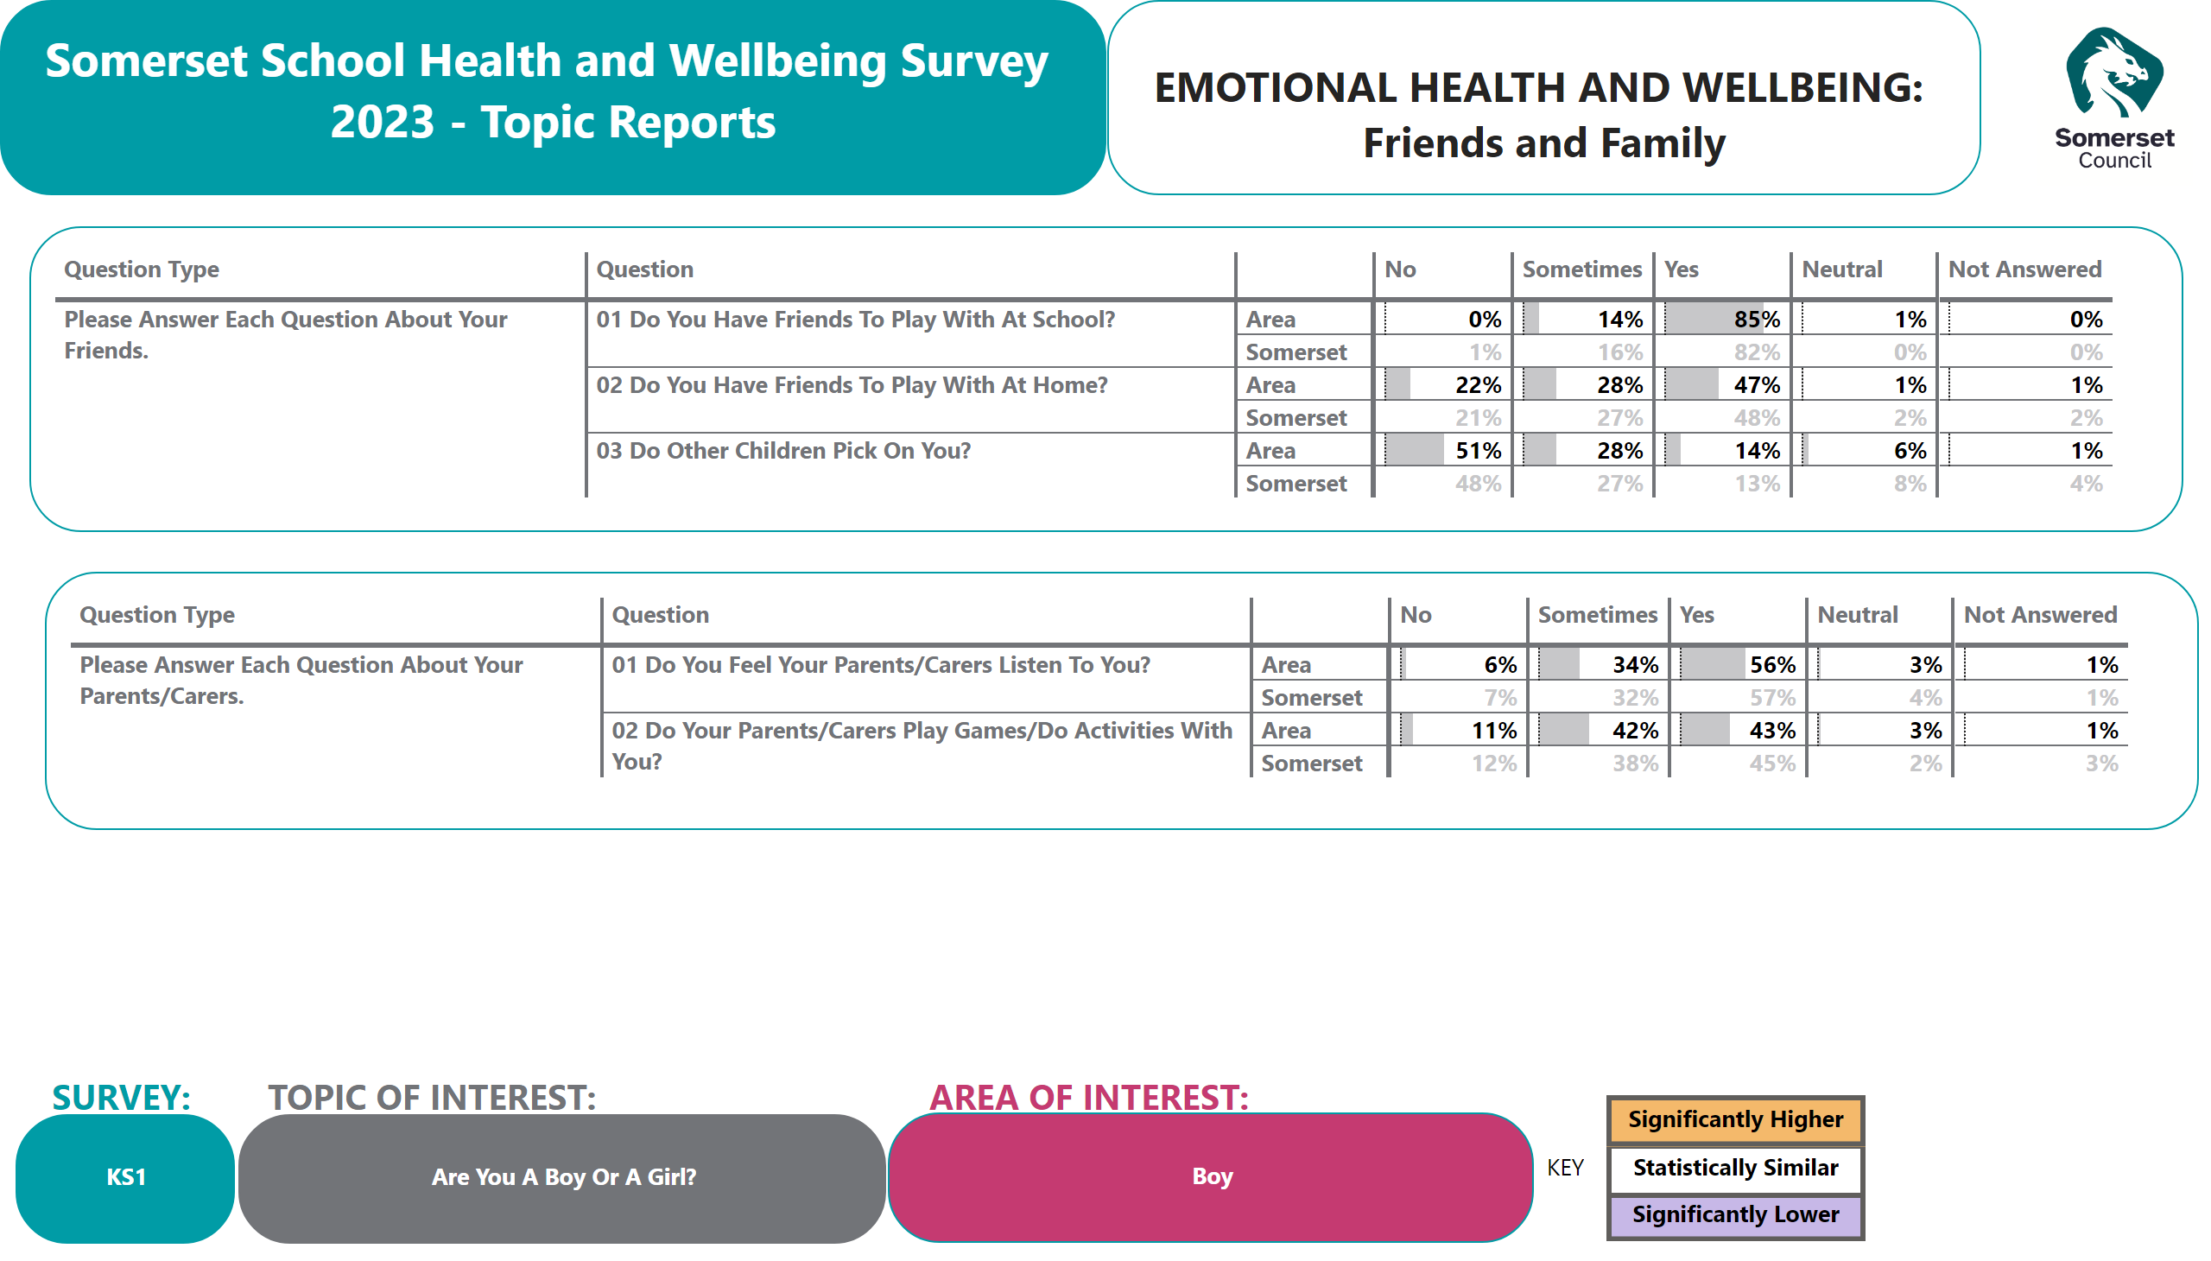
EHWB: Friends and Family
Notes:
textbox
No alt text provided
pivotTable
No alt text provided
Responses
No alt text provided
actionButton
No alt text provided
Responses
No alt text provided
actionButton
No alt text provided
Responses
No alt text provided
actionButton
No alt text provided
actionButton
No alt text provided
actionButton
No alt text provided
actionButton
No alt text provided
actionButton
No alt text provided
Text box 2023
No alt text provided
pivotTable
No alt text provided
image
No alt text provided

Slide 8
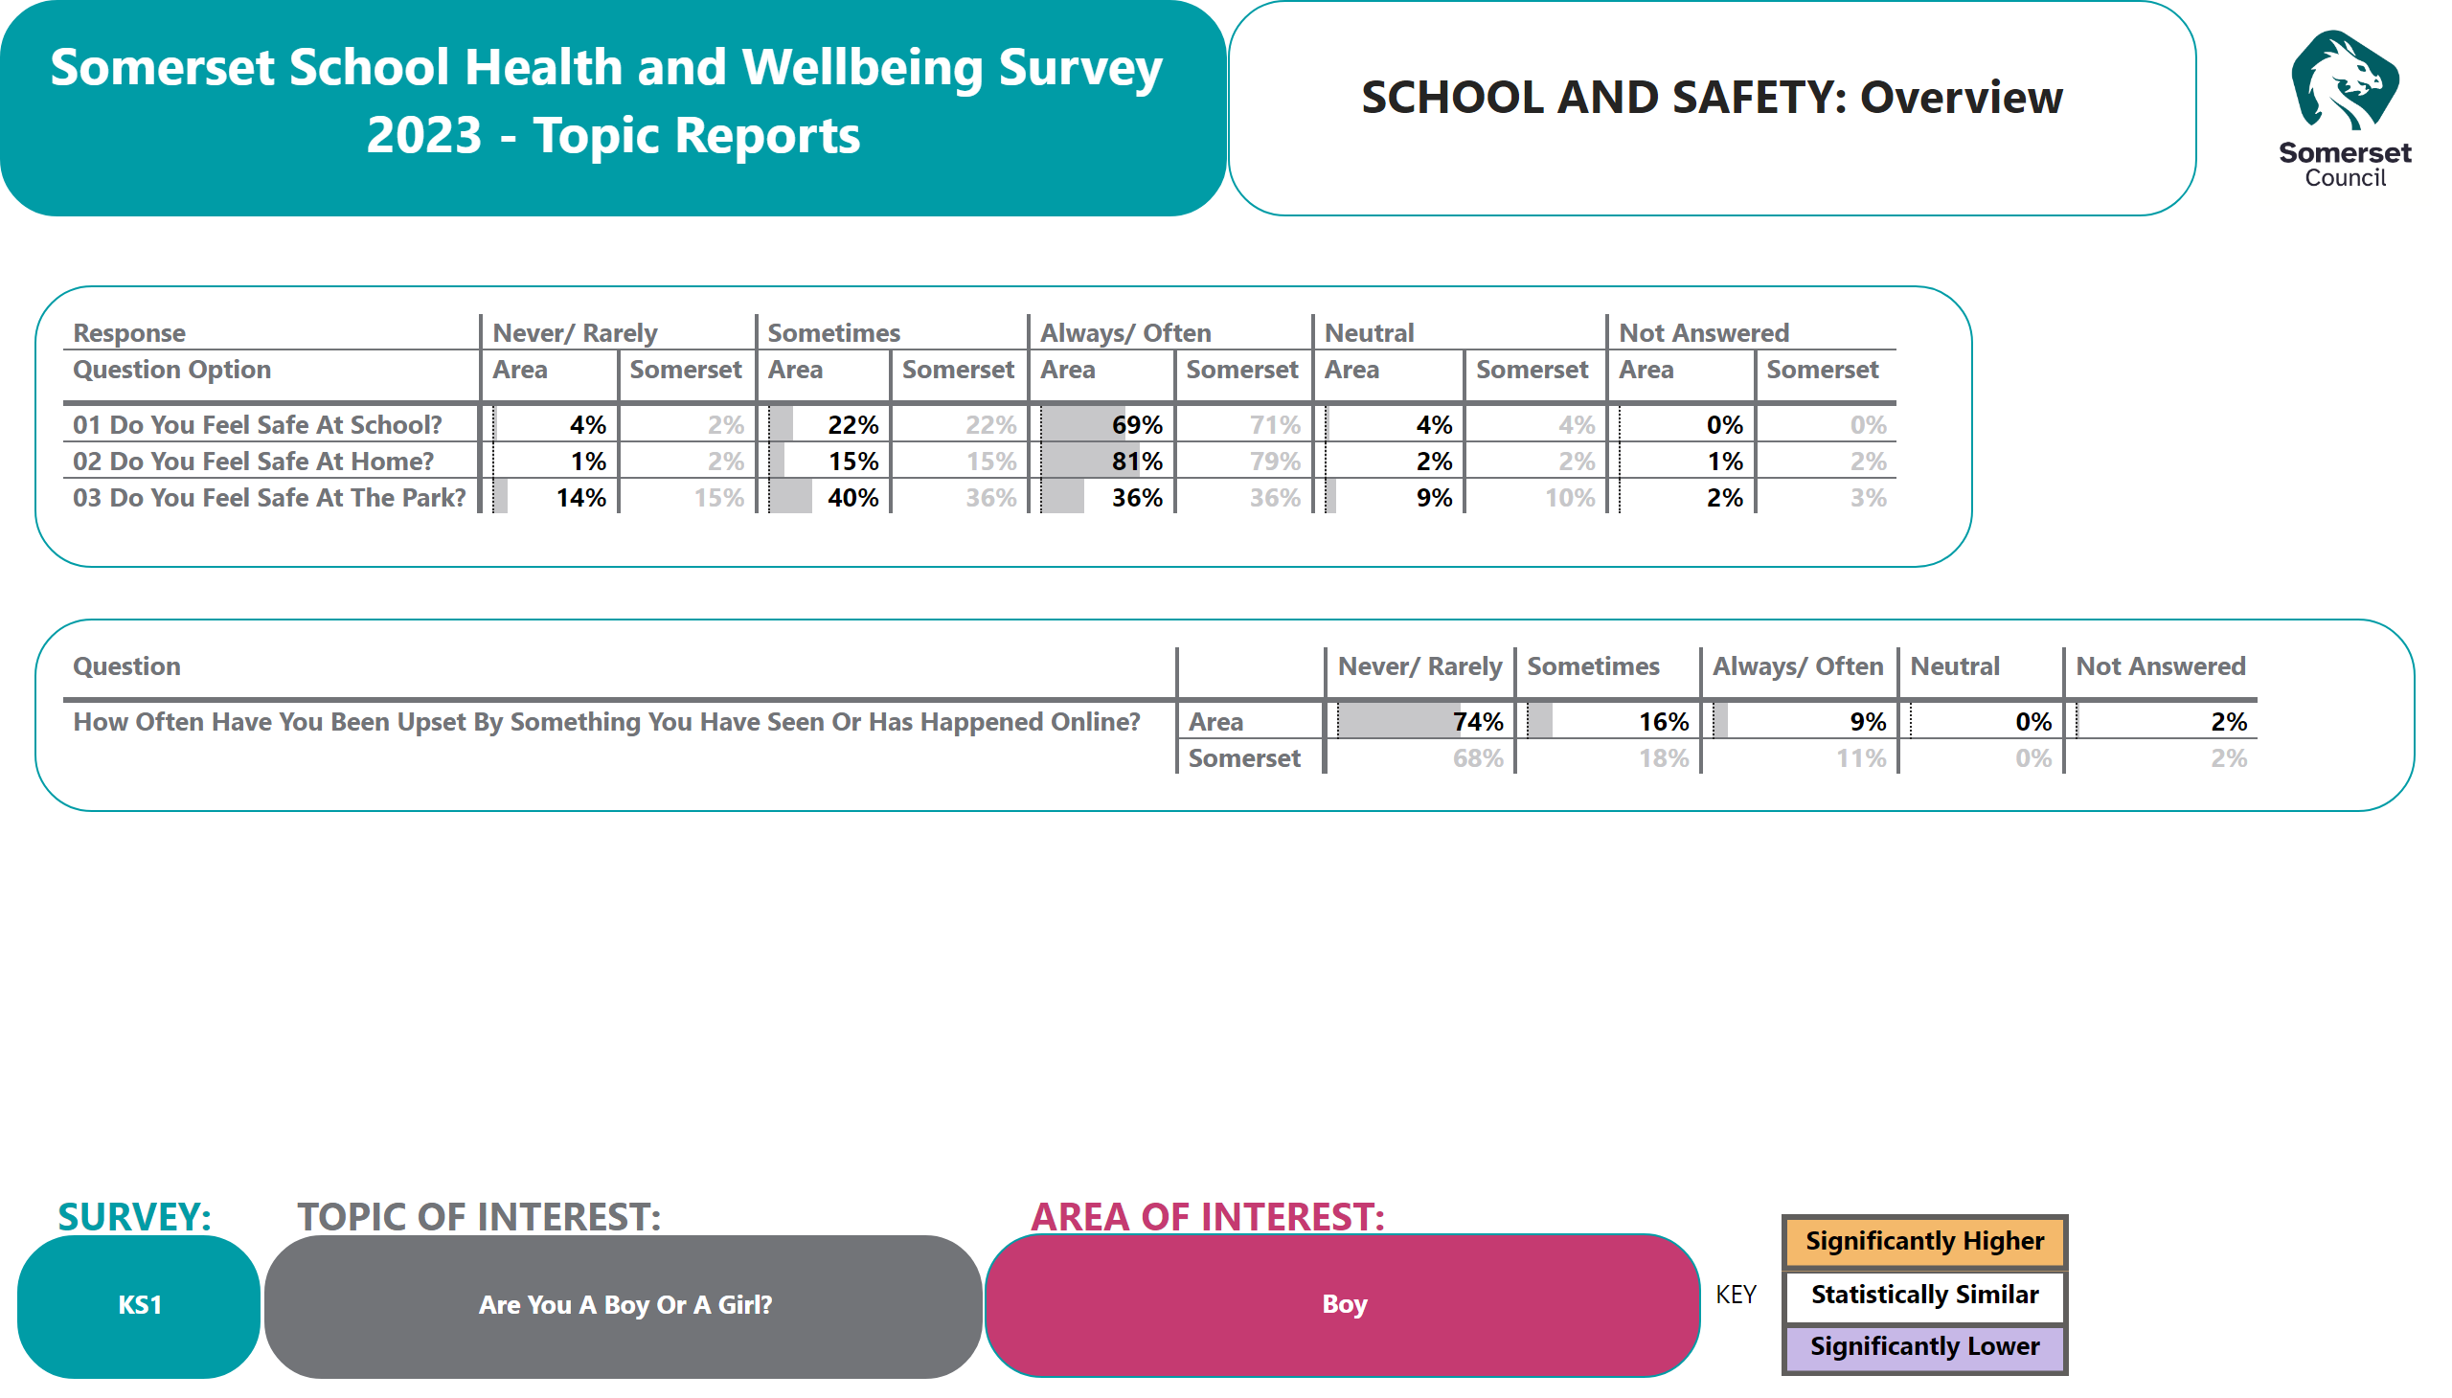
School and Safety: Overview
Notes:
pivotTable
No alt text provided
textbox
No alt text provided
pivotTable
No alt text provided
Responses
No alt text provided
actionButton
No alt text provided
Responses
No alt text provided
actionButton
No alt text provided
Responses
No alt text provided
actionButton
No alt text provided
actionButton
No alt text provided
actionButton
No alt text provided
actionButton
No alt text provided
actionButton
No alt text provided
Text box 2023
No alt text provided
image
No alt text provided

Slide 9
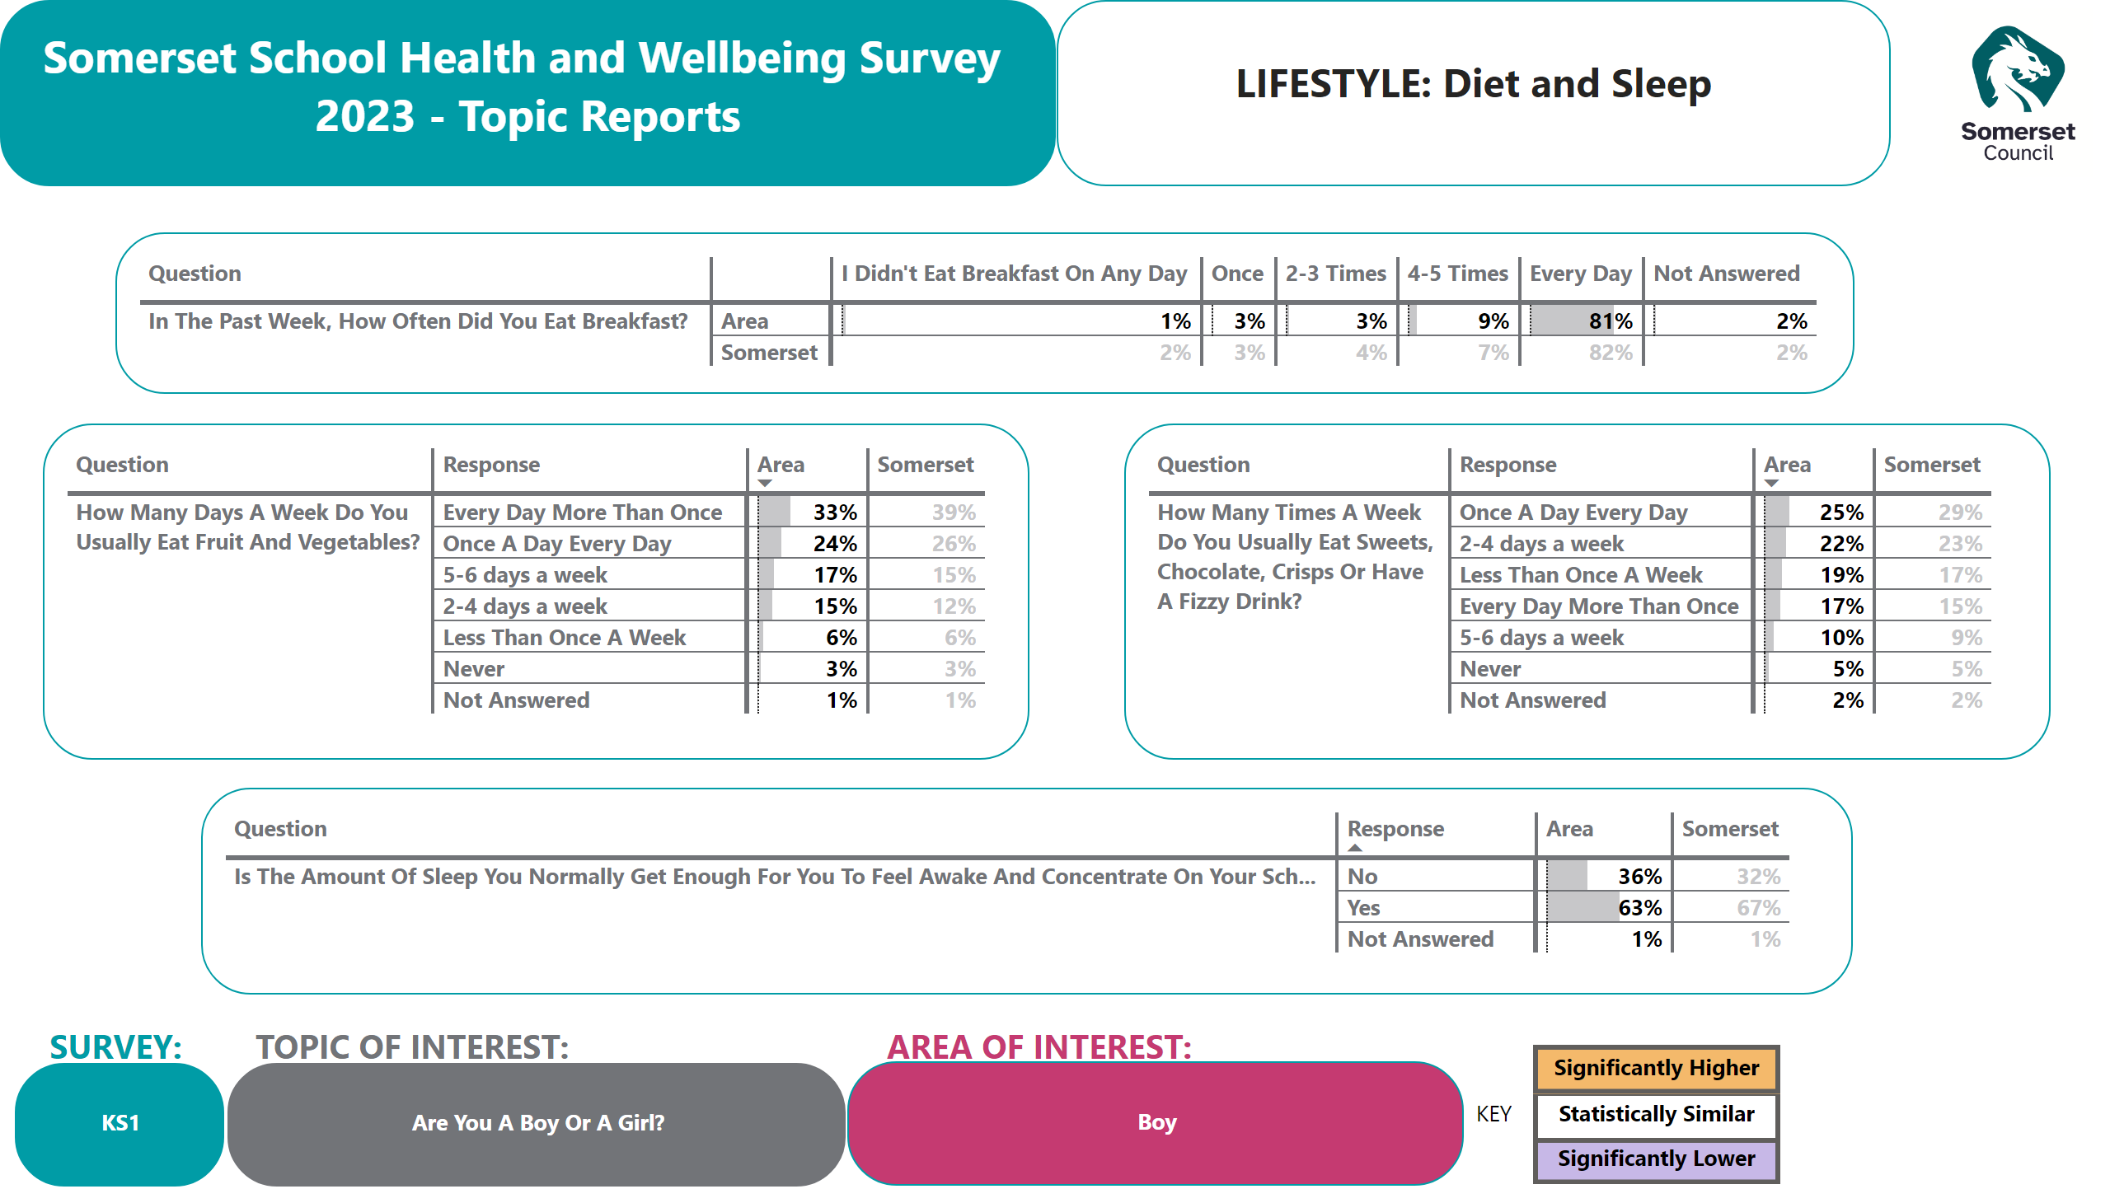
LIFESTYLE: Healthy Eating
Notes:
textbox
No alt text provided
pivotTable
No alt text provided
pivotTable
No alt text provided
Responses
No alt text provided
actionButton
No alt text provided
Responses
No alt text provided
actionButton
No alt text provided
Responses
No alt text provided
actionButton
No alt text provided
actionButton
No alt text provided
actionButton
No alt text provided
actionButton
No alt text provided
actionButton
No alt text provided
pivotTable
No alt text provided
Text box 2023
No alt text provided
pivotTable
No alt text provided
image
No alt text provided

Slide 10
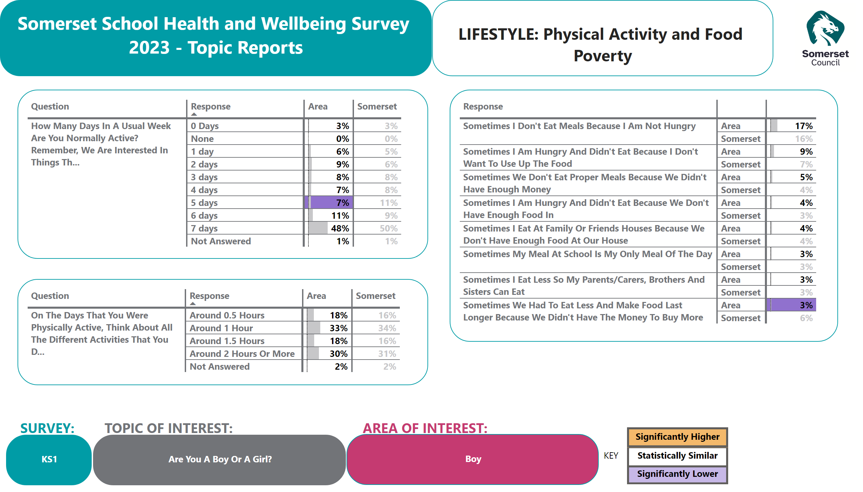
LIFESTYLE: Diet and Activities
Notes:
pivotTable
No alt text provided
pivotTable
No alt text provided
textbox
No alt text provided
Responses
No alt text provided
actionButton
No alt text provided
Responses
No alt text provided
actionButton
No alt text provided
Responses
No alt text provided
actionButton
No alt text provided
actionButton
No alt text provided
actionButton
No alt text provided
actionButton
No alt text provided
actionButton
No alt text provided
pivotTable
No alt text provided
Text box 2023
No alt text provided
image
No alt text provided

Slide 11
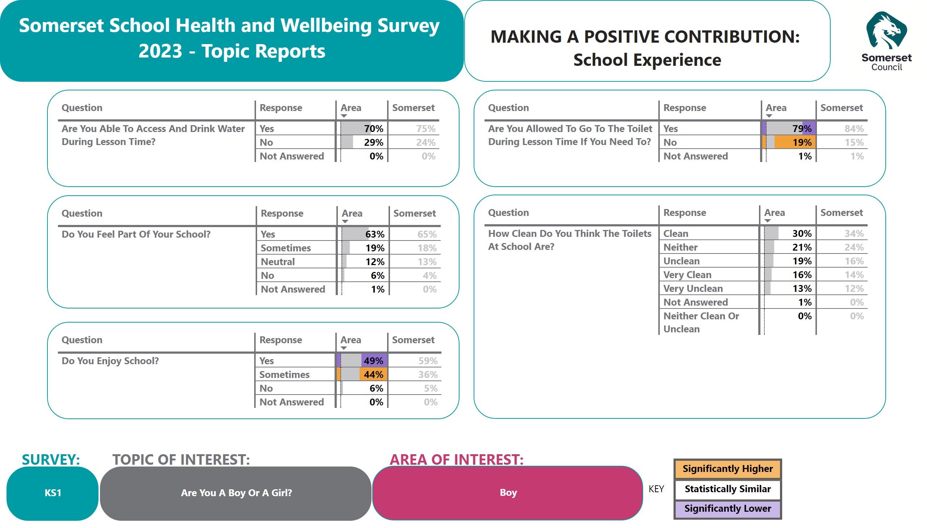
MAKING A POSITIVE CONTRIBUTION: School Experience
Notes:
textbox
No alt text provided
Responses
No alt text provided
actionButton
No alt text provided
Responses
No alt text provided
actionButton
No alt text provided
Responses
No alt text provided
actionButton
No alt text provided
actionButton
No alt text provided
actionButton
No alt text provided
actionButton
No alt text provided
actionButton
No alt text provided
pivotTable
No alt text provided
Text box 2023
No alt text provided
pivotTable
No alt text provided
pivotTable
No alt text provided
pivotTable
No alt text provided
pivotTable
No alt text provided
image
No alt text provided

Slide 12
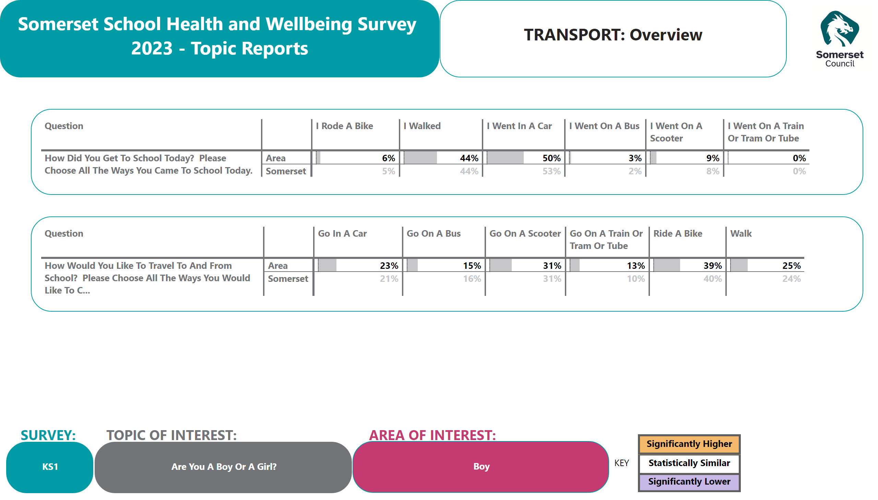
TRANSPORT: Overview
Notes:
textbox
No alt text provided
pivotTable
No alt text provided
Responses
No alt text provided
actionButton
No alt text provided
Responses
No alt text provided
actionButton
No alt text provided
Responses
No alt text provided
actionButton
No alt text provided
actionButton
No alt text provided
actionButton
No alt text provided
actionButton
No alt text provided
actionButton
No alt text provided
Text box 2023
No alt text provided
pivotTable
No alt text provided
image
No alt text provided

