Slide 1


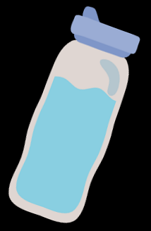

Are you ready to become a
‘Water Warrior’?
I’m Will, a ‘Water Warrior’
Notes:
Start of assembly: Introduce Will (as the mascot) and get children engaged (e.g., Ask “does anyone know what a water warrior is…”)

Slide 2

Get your thinking hats on…
...this is something you can find
in a lake and in a stream.
When frozen it turns to ice.
When boiled it turns to steam.
What Am I?
Notes:
Riddle time!
ANSWER: Water

Slide 3

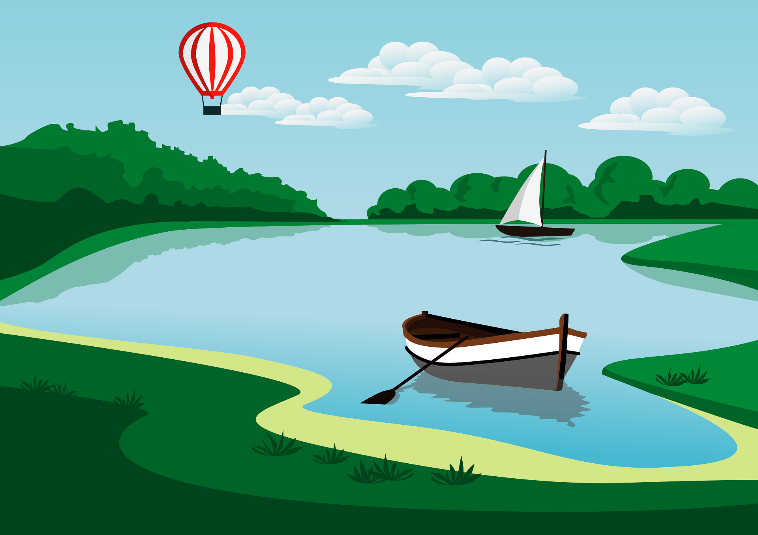

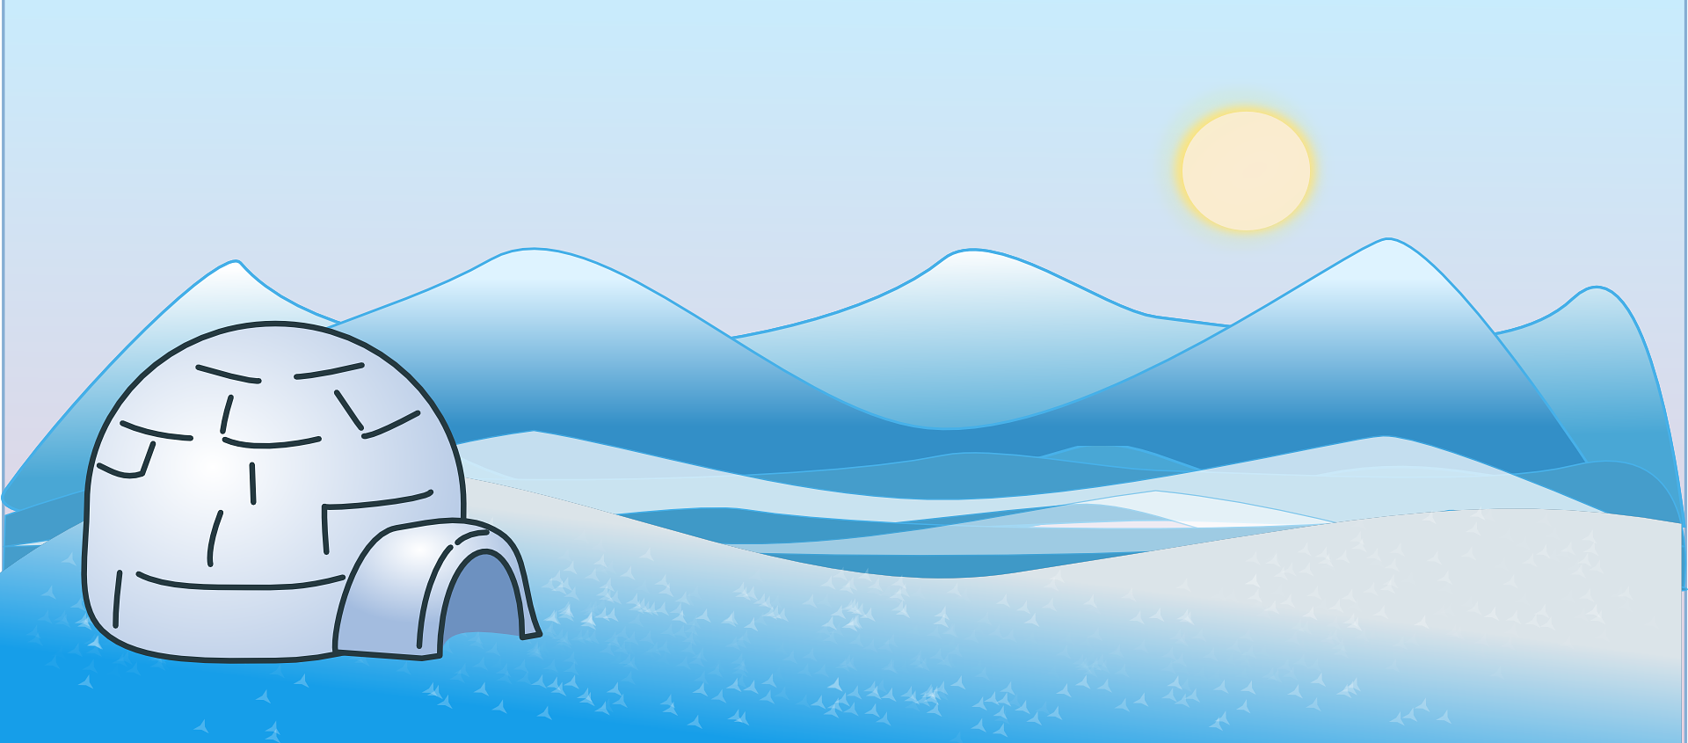
Where can water be found on our planet?
Notes:
Decision for presenter: Either get the children to contribute and tell you what they see in pictures or presenter just states each picture.
Speak the text below
Water is essential for life. 70% of the earth’s surface is water and without it there would be no life on the planet at all. Some people have lots of safe water to use, whereas others have very little.
Use pictures to show where water can be found on earth
Lake
Ice
Clouds

Slide 4
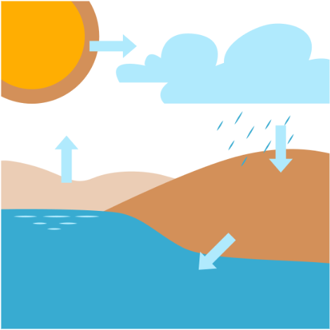

Condensation
Let’s watch this video together!
Evaporation
Precipitation
Transpiration
Wessex Water video:
https://youtu.be/tYFTEembPR0
Notes:
- Play video

Slide 5

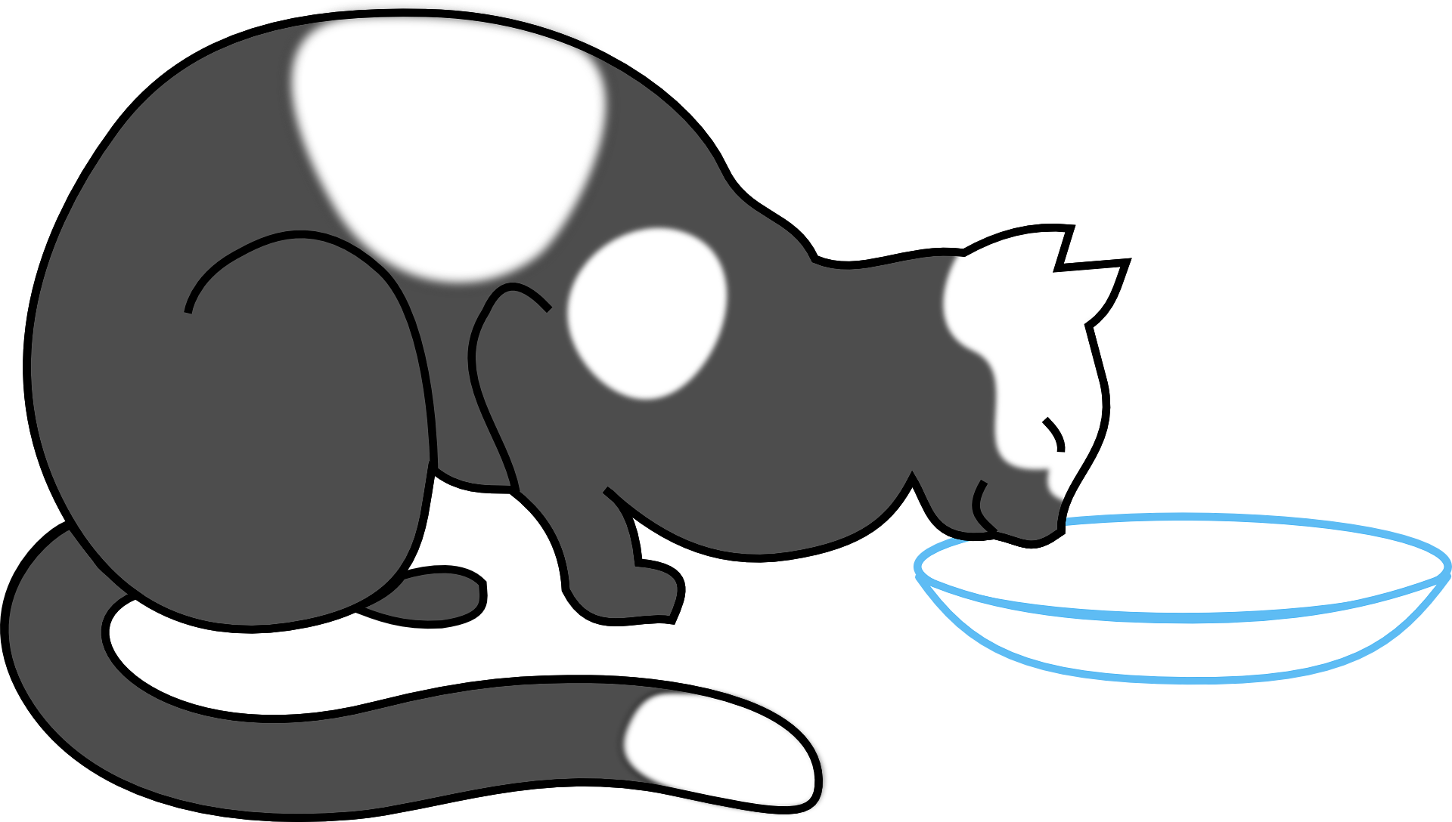

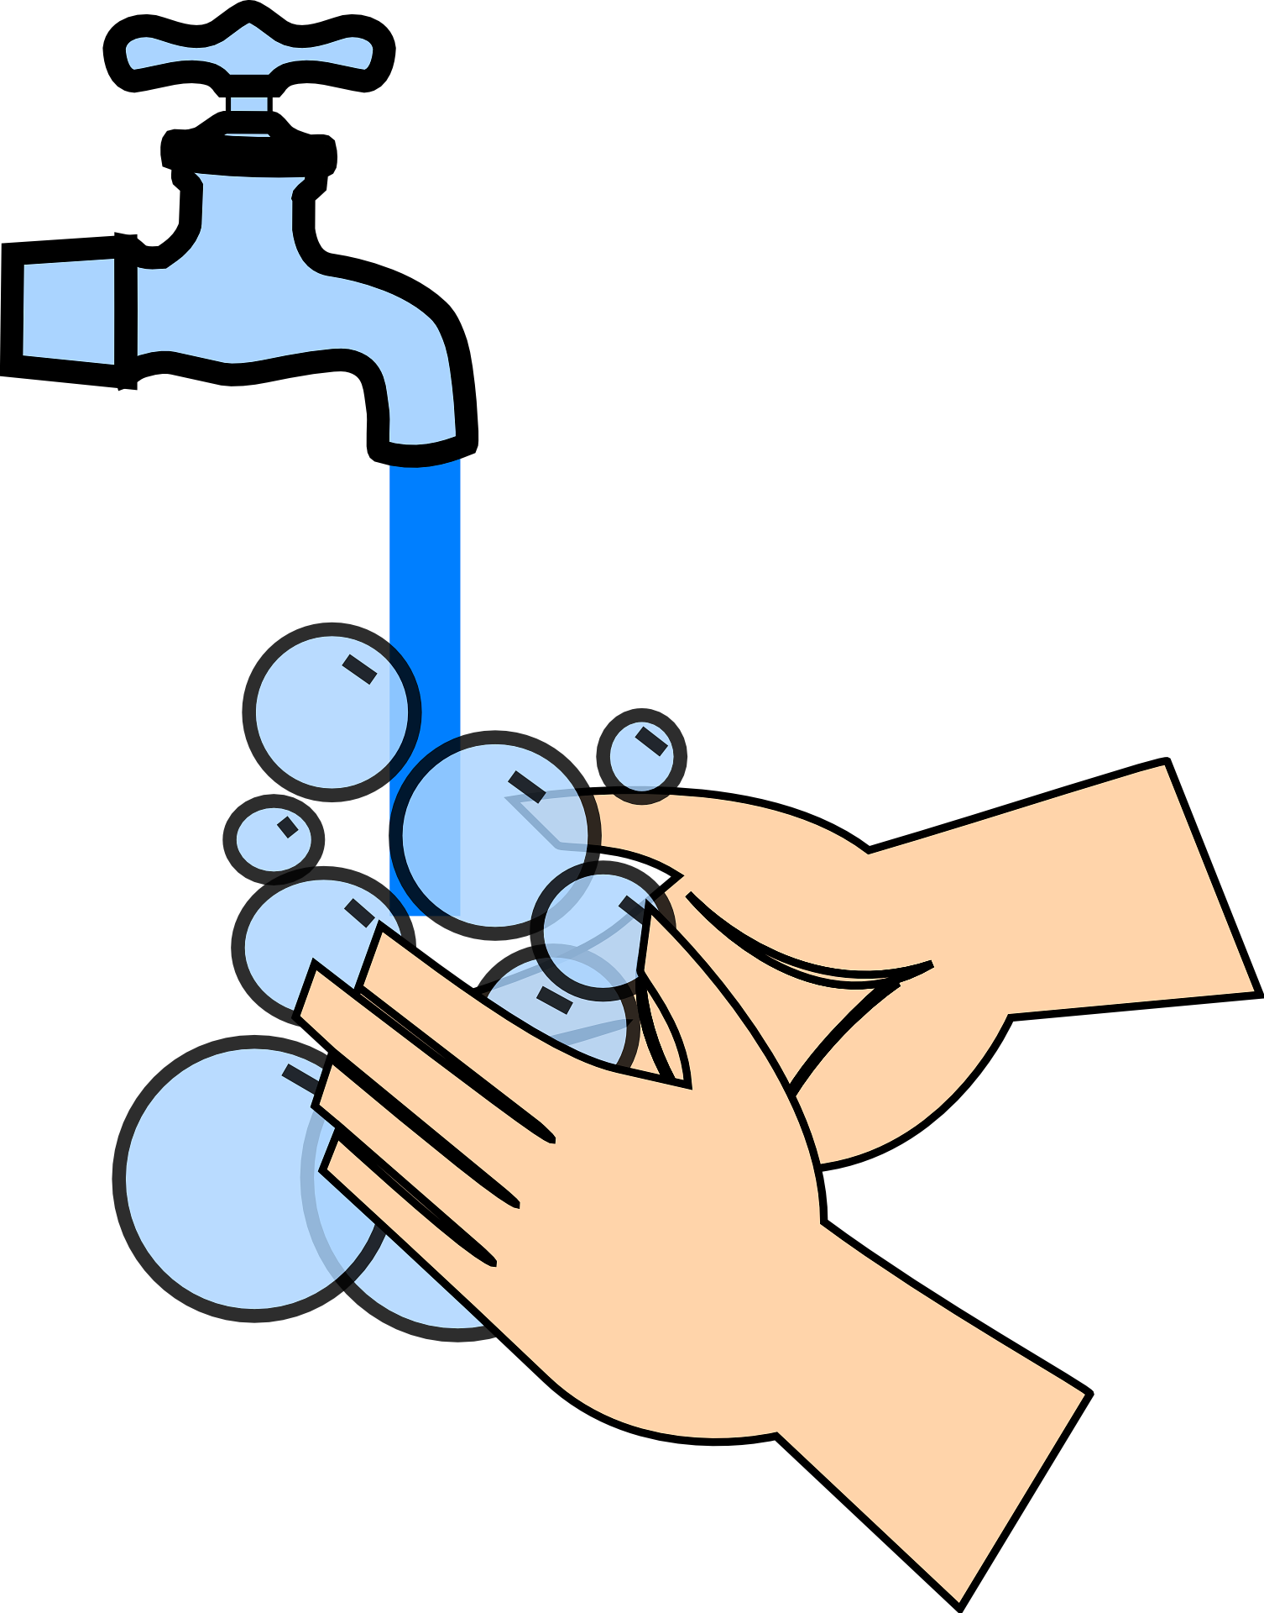
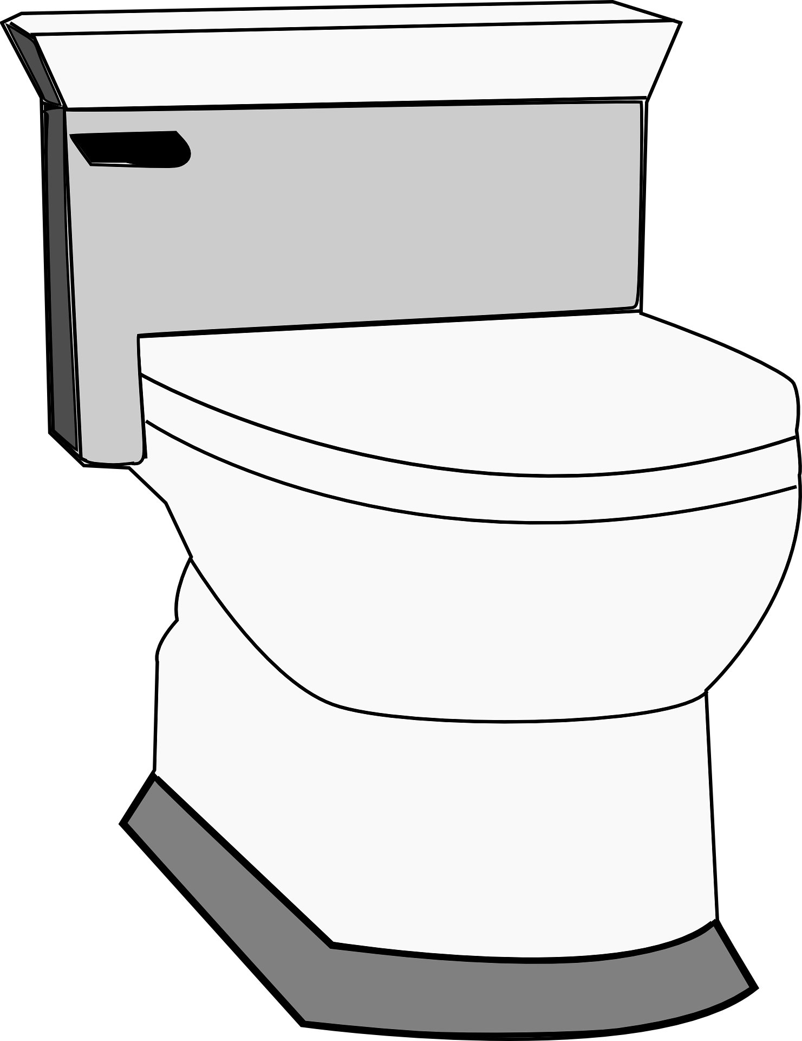
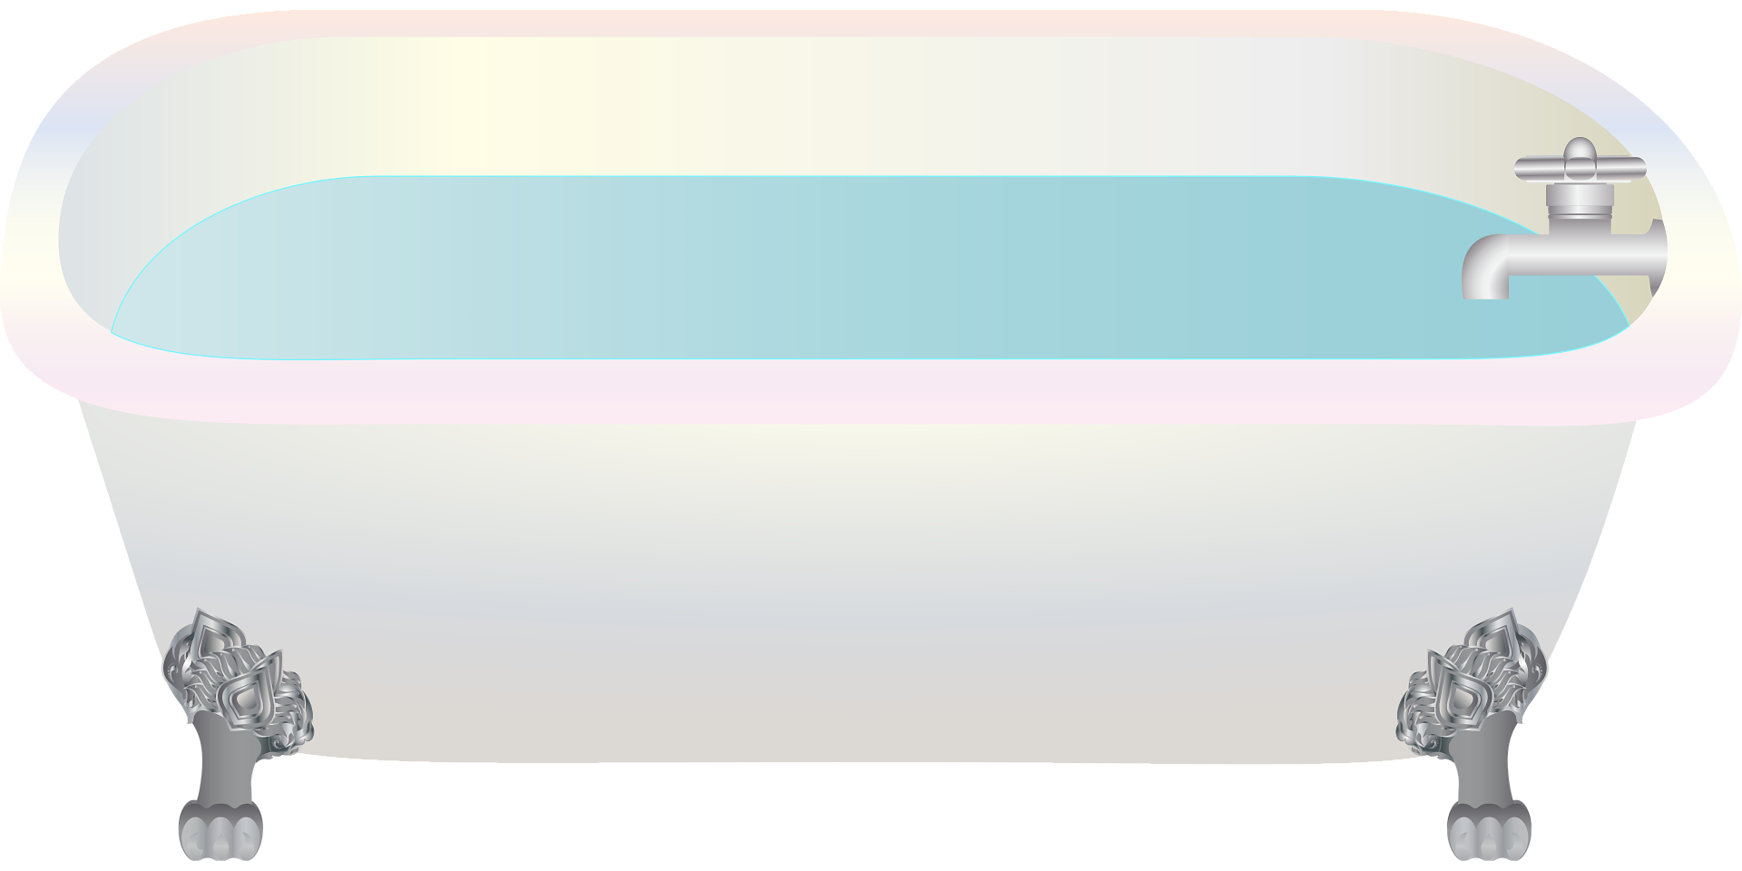
Think about your day so far, have you used water?
Notes:
Presenter decision: Either ask children first before showing images or just show each picture and state.
Ask the group if they can think about how they have used water so far in their day.

Slide 6
Water & Our Body
Our bodies are made up of more than 60% water. We are constantly losing water through:
Breathing / Talking
Going to the toilet
Sweating
Running, jumping, skipping
Video: Why is water important? 2nd level - BBC Bitesize
Notes:
- Go through content on page first.
- Next, play BBC bitesize video about hydration

Slide 7
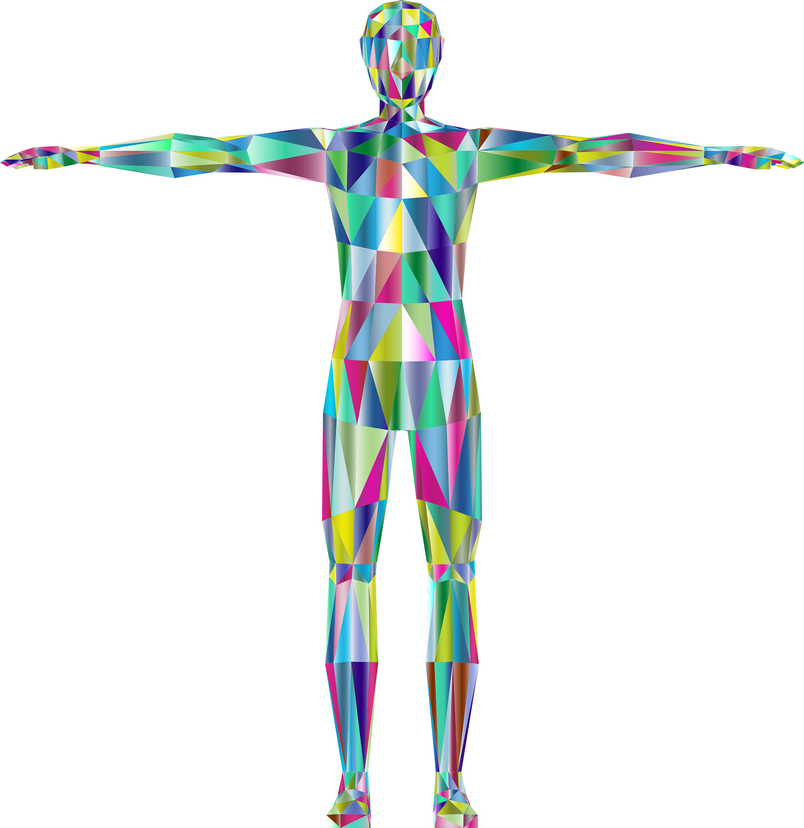



Where do we find water in our body?
Brain & Eyes
Lungs
Heart & Blood
Kidneys
Muscles
Notes:
Presenter decision: Get children to take a guess of body parts / organs that the arrows are pointing to. Otherwise, just state each one.
When talking about ‘muscles’, ask children to stand up from their seats and run on the spot as fast as they can for 5 seconds.

Slide 8

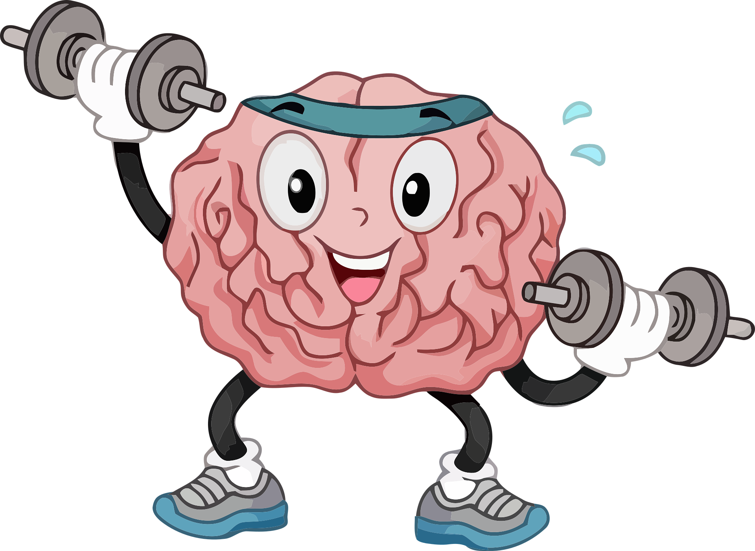
Energy
Why should
we drink water?
Attention
Memory
Brain Power
Notes:
Arrows showing reasons why we should drink water
Energy: Hydration is important to keep energy levels up for learning & playtime (refer back to running on the spot they have just done)
Attention: Hydration is important to maintain attention / concentration in class
Memory: Hydration is important to support learning and retain information
Brain Power: Hydration is important for efficient learning / thinking
Look out for signs of dehydration:
Loss of attention
Brain fog / forgetful
Isolation from learning
Anger / frustration

Slide 9
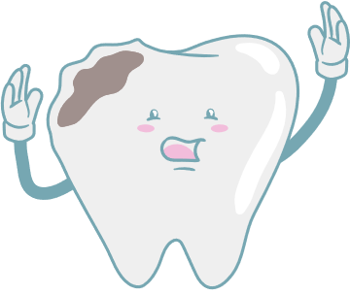
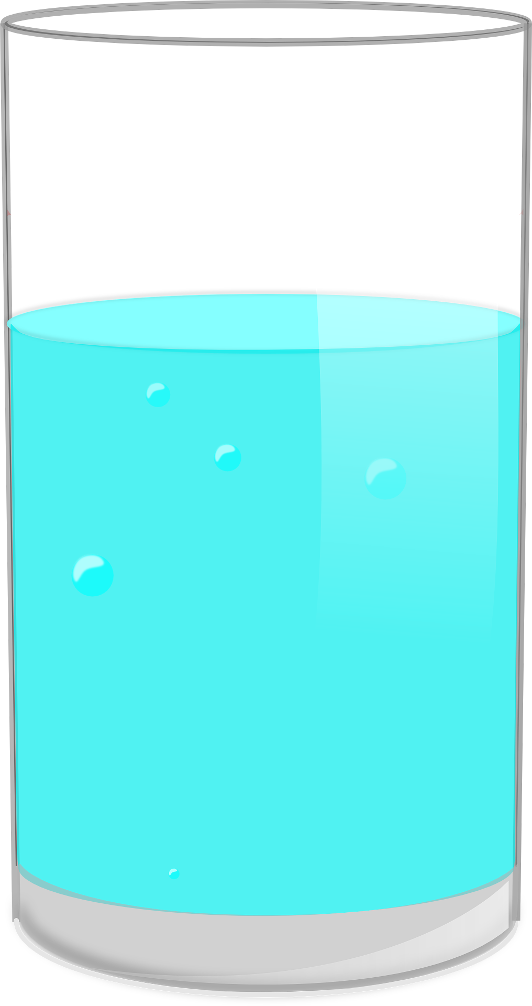


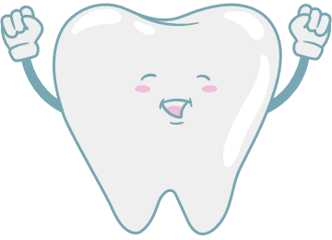
Did you know that too much sugar can damage our teeth?
Guess how many teaspoons of sugar there are in these drinks…
What about our teeth?
6
0
Notes:
Ask the children if they know that sugar can damage their teeth, and how (pain, decay…).
Ask the children to guess how many teaspoons of sugar are contained in this popular fizzy drink (6) and how many there are in water (0).
Reveal the answers!

Slide 10

Are you ready to join me and my Water Warrior friends?
Let’s go!
Notes:
Read the question out to the children with enthusiasm ☺

Slide 11





Top tips on your mission to becoming a Water Warrior
Are you ready to take on the mission?
1
Refill your 500ml clear water bottle at least once per day.
2
Collect glasses to complete your weekly water mission shown on your classroom chart.
3
Encourage your friends and family to join the mission on becoming water warriors!
Keep this up and you will always be a water warrior!
4
Notes:
Read out each tip
Mention that more information about learning resources / games will be available for teachers to use in class. (If available, show the physical copy of chart to show example to children)

Slide 12
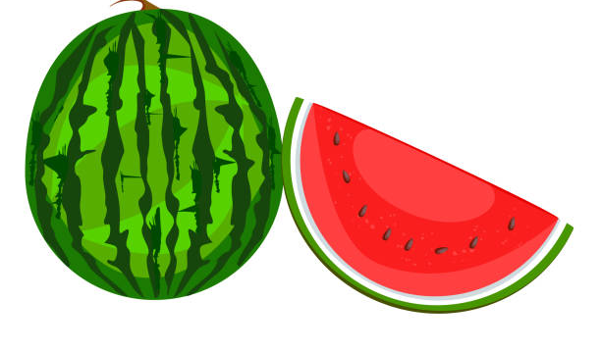



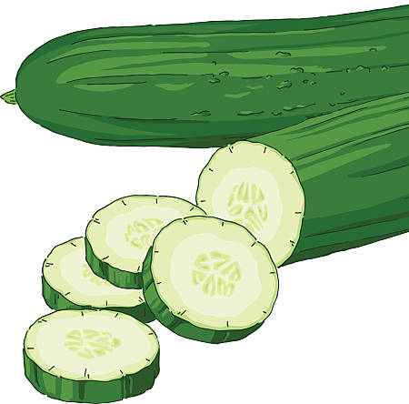
Did you know…
Fruit and Vegetables contain lots of water.
If we eat our '5-a-day’, this will add to your water intake.
Notes:
Conversation: Talk about how fruit & vegetables will contribute to their water intake as part of a healthy balanced diet.
Emphasize water as primary source first.
Adapt terminology from paragraph on slide if needed to suit age / ability.

Slide 13

Quiz Time
Fact or
Fiction?

Slide 14

Water is found naturally in both vegetables and fruit.
Fact or Fiction?

Slide 15

FACT
Notes:
Ask the children to guess which vegetables and fruits are the richest in water.
Watermelon, tomatoes, cucumbers, oranges, lettuce...

Slide 16
A single-use plastic bottle can take more than 400 years to break down in nature.
Fact or Fiction?

Slide 17

FACT
Notes:
A single-use plastic bottle can take up to 450 years to decompose.
Plastic straws up to 200 years.
More information here: The lifecycle of plastics | WWF-Australia | The lifecycle of plastics | WWF Australia

Slide 18
Water is the best drink because it keeps you hydrated and helps keep the body working.
Fact or Fiction?

Slide 19


Water is the healthiest and cheapest choice for quenching your thirst at any time. It contains no sugars that can damage teeth.
FACT
Notes:
Drinks that don’t have added sugar or artificial sweeteners in are to prefer.
Milk is also a good (and nutritious) option!

Slide 20

Key messages from Will the Water Warrior…
Always keep a refillable water bottle with you and try to refill this once a day.
Keep hydrated by drinking water and through eating your fruit and vegetables.
Continue your water missions at home with your family and friends.
We love water!
Notes:
Read key messages from Will.

Slide 21

A Final message from Will…
Sing Along!
The Water Song - Bing video
Notes:
Play the Song ☺

