Slide 1
Benefits of a good night’s sleep
Beatrice Guest
Somerset Youth Parliament Advisory Group Member

Slide 2
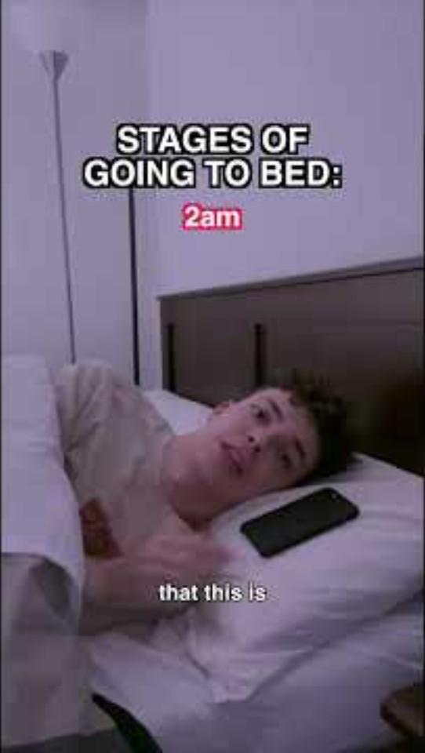
Stages of Sleeping
(fix your sleeping cycle)
By Gregor Reynolds

Slide 3
Fun facts
Part of your brain stays awake while you sleep
Severe sleep deprivation can cause hallucinations
Sea Otters sleep holding paws
Your body temperature has to drop, for you to fall asleep
Caffeine can disrupt your sleep – even 6 hours later!
REM sleep boosts creativity
Your brain works harder when you’re asleep than when you’re awake
Lack of sleep causes your body to swell
Sleep deprivation shuts the body down faster than a lack of food.
10% of people dream entirely in black and white
A 75 years old, will have spent 25 years sleeping, 6 years of which will be in dream land.

Slide 4
Did you know?
Young people need an average of 8-10 hrs sleep a night?
Nearly 70% of us DON’T get the recommended amount of sleep!
45% of us are still checking our phones after we’ve gone to bed
91.4% of young people with mental health issues have had problems with sleep
And extreme sleep deprivation in teens has been linked to anxiety, depression, and weight gain.

Slide 5
Some physical benefits of getting a regular great night’s sleep
Faster immune response
Reduced risk of heart condition
More stable mood & emotions
Better memory & focus
Better skin
Easier to maintain a healthy weight

Slide 6
Top tips for better sleep
Try not to drink caffeine after Lunch but especially 2 hours before bed
Create a calming bedroom space
Try to not have your phone in your room or look at screens for an hour before bed
Try having a relaxing bedtime routine- meditation, soft lights, gentle music. You could try a herbal tea designed for helping with sleep

Slide 7
You’re worth it!
Get the sleep you deserve
because you’ll look and feel great
Be the boss of your own life

Slide 8
For more information and support
How Can Sleep Affect A Teenagers Education? | Matthew Walker
Teenage Brain and Sleep
Teen Sleep Hub - Top Tips - Anxiety
Tips to help weary teens get a good night’s sleep

Slide 9
Somerset Youth Parliament
Our group of volunteers is open to local young people aged 10-25 years
We have 3 elected Members of youth parliament
And a diverse Advisory Board
We run projects and campaigns reflecting the interests, concerns and in response to the priorities of young people
The aim of the group is to empower young people and elevate young people’s voices by working with decision makers and services to improve lives.
If you would like to find out more about us please go to our website here:
Somerset Youth Parliament

