Slide 1

The Family Pack Lifestyle
Welcome
This is an informal information session that has been developed to help explore and better understand the following subjects:
Sleep
Healthy Eating
Routines
School Readiness
Sibling Rivalry
We understand that we all parent in slightly different ways, and what one parent does may not work for the other. You need to do what you feel may work best for you and your family. We hope the information in these sessions will be helpful”

Slide 2
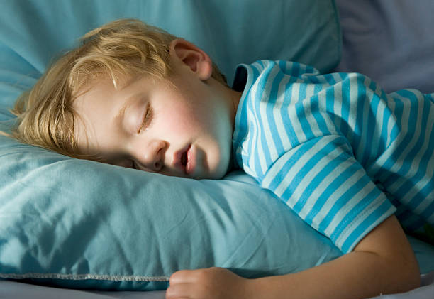
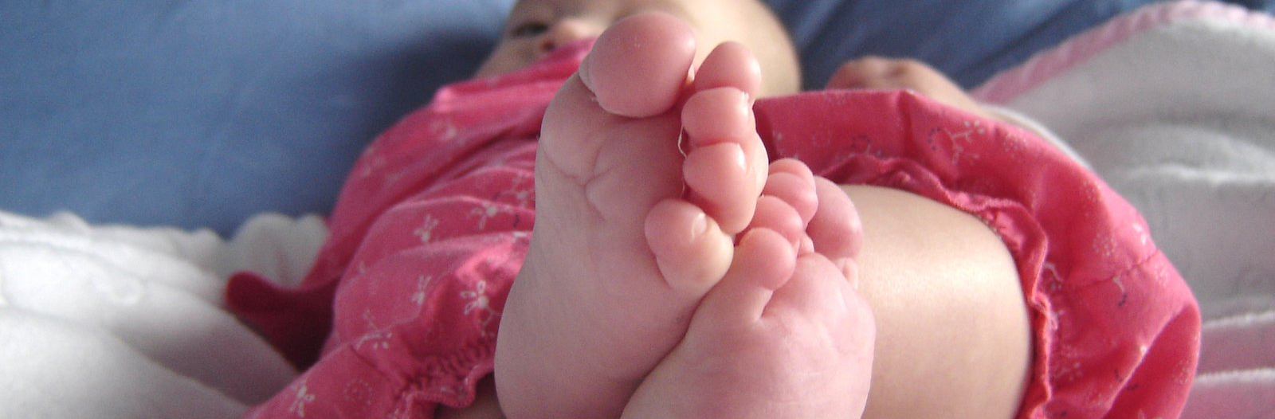
Sleep

Slide 3
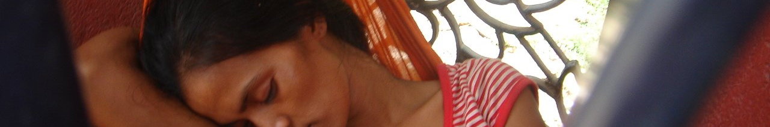
Understanding Sleep
How much sleep do think is needed?
3 to 5 years? 6- 13 years? 14- 17 years? Adults?
11/12 hours
9/10 hours
9 hours
6-8 hours
How do you feel when you haven’t slept well?
Unable to concentrate,
Irritable?
Shorter fuse?
How else might you feel?
Remember it is the same for your child:
What is your child like when they haven’t slept? What helps them?
Therefore we need to mindful of the importance of sleep and do what we can to support good sleep routines.

Slide 4
Sleep Routines
Why is Sleep so important?
Sleep is extremely important to support children’s development, both physically and mentally. Establishing good sleep patterns can help them to achieve their full potential.
If we do not get enough sleep, it can cause:
Concentration difficulties, stress, more anxious, hyperactivity and behaviour difficulties, poor memory.
What can prevent a good sleep routine?
Certain foods can affect sleep, technology/screen time, struggle to switch off, worries/active mind, FOMO, (basically the same struggles we may have)

Slide 5

What can you do to help?
Sleep isn’t just the time that they spend in bed.
Sleep routines should be prepared for up to an hour before the child goes to bed.
What can you do to help improve your child’s sleep routine?
Infants (4-7)
Turn off screens
Dim lights/close curtains
Quiet/calm activities
Prepare for bed, Pj’s, brush teeth (keep the order the same)
Storytime / bath time / warm milk
Regulate the room temperature
Juniors (8-11)
Turn off screens / remove media items. (give fair warnings / countdown)
Dim lights/close curtains
Quiet/calm activities
Prepare for bed, Pj’s, brush teeth etc.
Storytime / bath time / Talk time / conversation
Regulate the room temperature
Secondary (12-16)
Turn off screens / remove media items. (give fair warnings / countdown)
Dim lights/close curtains
Quiet/calm activities
Prepare for bed, Pj’s, brush teeth etc.
bath / shower / play relaxing music / breathing techniques.
Regulate the room temperature

Slide 6

Teenagers & Sleep
There are many factors that keep teens from getting enough sleep.
Can you think of any causes that might affect sleep?
Here are a few things we have come up with…
Rapidly changing bodies
Busy schedules
Active social lives
A wrong view of sleep - it's not that important!
Technology and gaming
A noisy environment
Maybe lacking motivation? Impact of COVID

Slide 7
Practical Advice
Things that might be helpful? (this may vary)
When they are little, they might want you to lay with them for a little while. It may also be helpful to give them something that reminds them of a parent, nightlights, favourite comforting toys, a glass of water by their bedside, agreed snacks (Bananas, yoghurt, milk etc.)
What do you do that works for you?
As they get older:
We are aware that each child is different and no one approach will suit everyone it may be that they like the television on as a background noise, so set a sleep timer. If you don’t trust them not to turn it back on, you can remove the controller at an agreed time or when they have fallen asleep.
If your child/teen has access to other technology, you could remove the items at an agreed time. Talk to your child/teen explain the importance of sleep and agree a plan together?
Try things, see if it works. If your child is involved in the process, they are much more likely to engage with it (especially as they get older) .

Slide 8
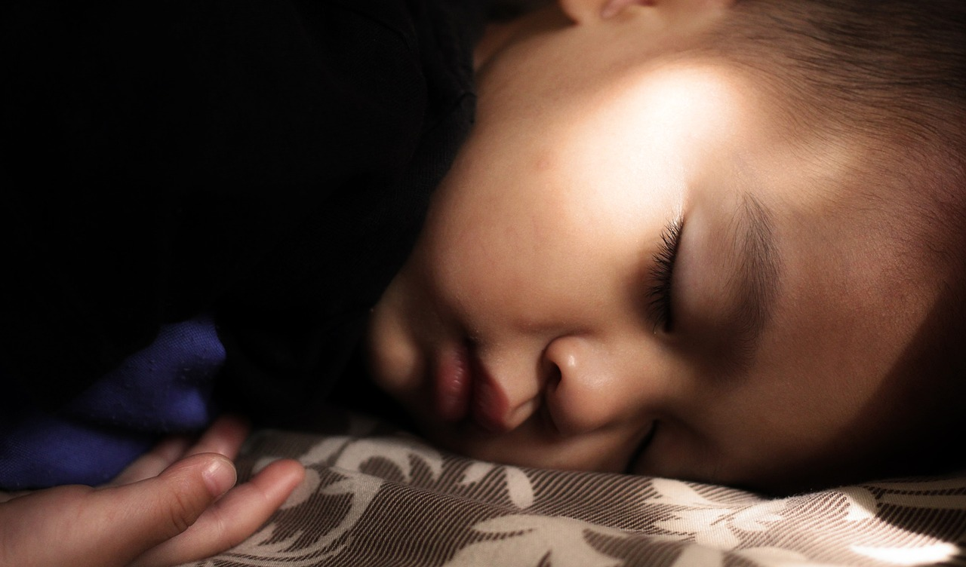
A good nights sleep
6 golden rules for a good night's sleep:
A regular bedtime
Spend 30 minutes before bedtime preparing for bed and do something relaxing
Avoid watching TV, using games or looking at screens before bed
Avoid eating and drinking before bed and avoid caffeine
Avoid vigorous exercise a few hours before bed
Have a bedroom environment that is sleep friendly: free from screens, noise and a consistent temperature.
Conversation starters when discussing sleep:
Share any worries that you may have about them not getting enough sleep, share any observations you may have, agree routines, try things...
What ideas do you have? Do you have any positive experiences to share?

Slide 9

Handouts
Sleep diary for children & Teens: http://www.sleepforkids.org/pdf/SleepDiary.pdf
https://www.nhs.uk/livewell/insomnia/documents/sleepdiary.pdf
Sleep Council:
https://sleepcouncil.org.uk/advice-support/sleep-advice/sleep-hygiene/
NHS Healthy sleep tips for children:
https://www.nhs.uk/live-well/sleep-and-tiredness/healthy-sleep-tips-for-children/
The good night guide for children:
https://sleepcouncil.org.uk/wp-content/uploads/GNGC-website-view.pdf
NHS Sleep tips for teenagers:
https://www.nhs.uk/live-well/sleep-and-tiredness/sleep-tips-for-teenagers/

Slide 10
Challenge Time & Feedback
We are now going to challenge you to put this information into practice with your family. Let’s see if it makes a difference?
Think about:
What was helpful?
What did you find most useful?
Was it realistic for you?
Would you feel comfortable explaining these ideas to someone else?
Any challenges?

Slide 11
The Family Pack Lifestyle
Welcome
This is an informal information session that has been developed to help explore and better understand the following subjects:
Sleep
Healthy Eating
Routines
School Readiness
Sibling Rivalry
We understand that we all parent in slightly different ways, and what one parent does may not work for the other. You need to do what you feel may work best for you and your family. We hope the information in these sessions will be helpful”

Slide 12
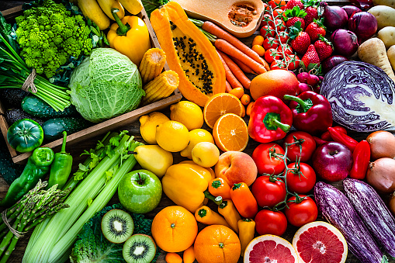
Healthy Eating

Slide 13
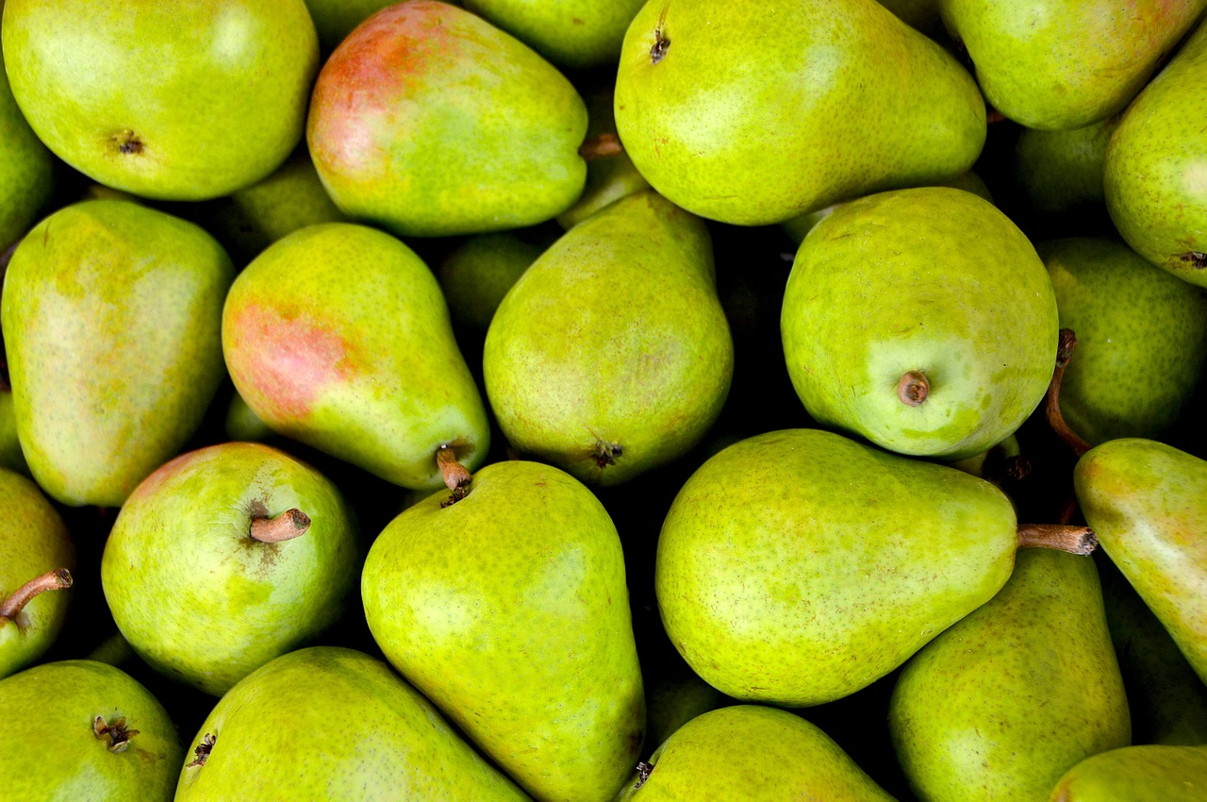
Healthy Eating
What is healthy eating?
Healthy eating helps to maintain or improve overall health, providing the body with essential nutrition. Eating a healthy, balanced diet is an important part of maintaining good health and can help you feel your best. This means eating a wide variety of foods in the right proportions and consuming the right amount of food and drink to achieve and maintain a healthy body weight.
Why is healthy eating so important for your children?
Developing good eating habits as a child has been shown to have significant impact on adult behaviours later in life. Healthy eating; more than physical activity, has the greatest impact on achieving and maintaining a healthy weight for both adults and children.

Slide 14
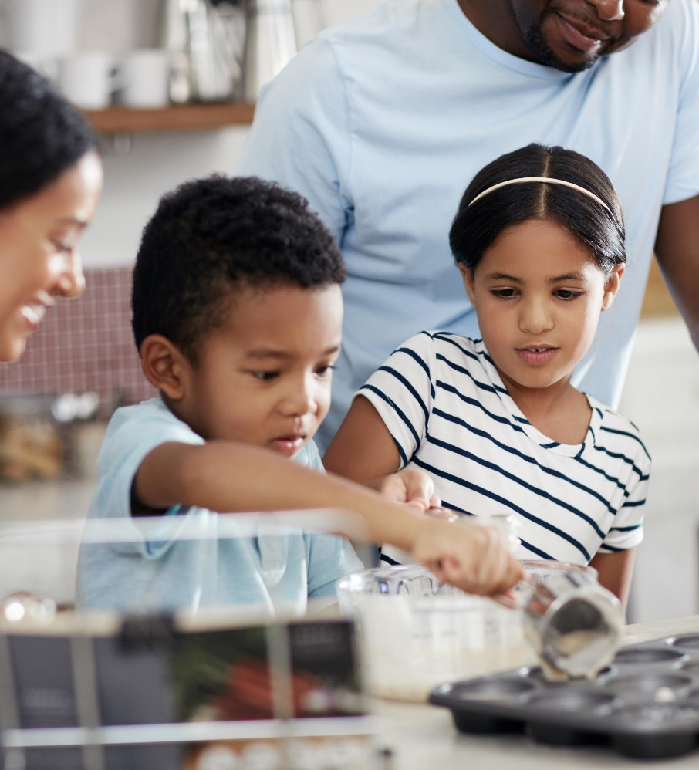
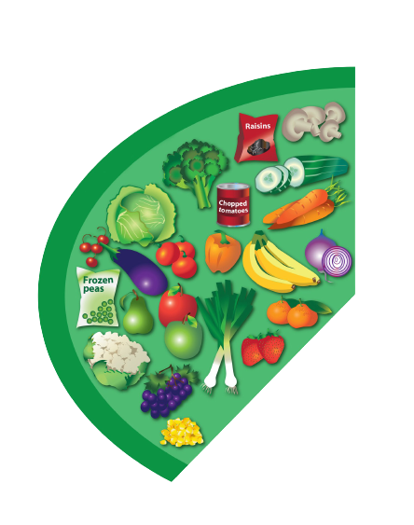

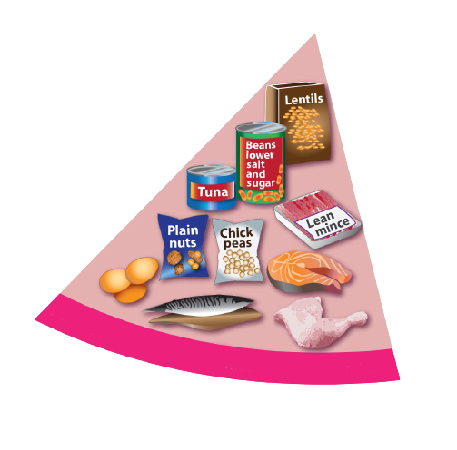
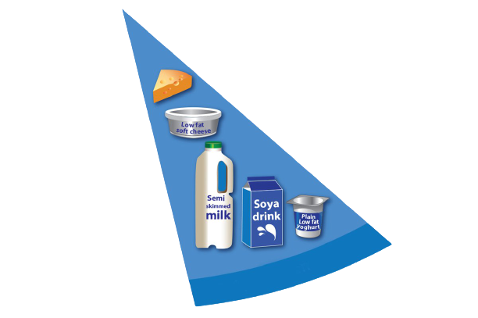
What is a Balanced Diet?
What should be on your children’s plate?
Base meals on potatoes, bread, rice, pasta or other starchy carbohydrates
We should eat at least 5 portions of a variety of fruit and vegetables a day
Have some dairy or dairy alternatives (such as soya drinks and yoghurts)
Eat some beans, pulses, fish, eggs, meat and other protein
Taken from the NHS eat well guide

Slide 15
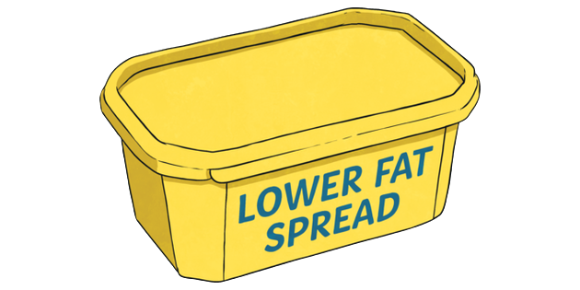
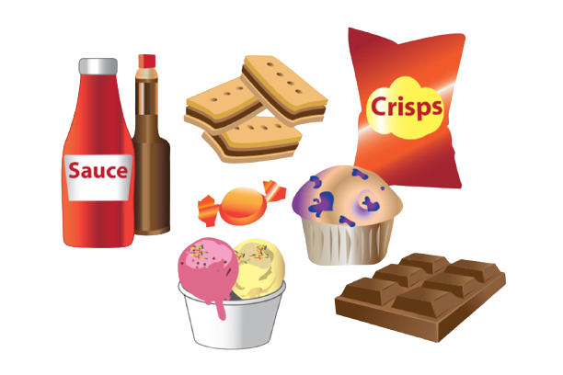


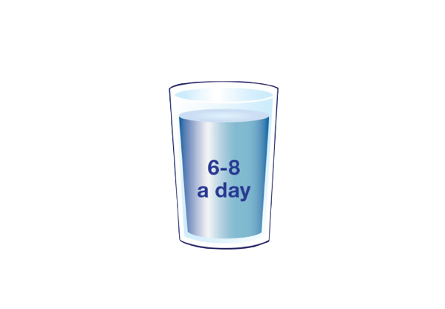
Remember:
Choose unsaturated oils and spreads, and eat in small amounts
Limit high fat foods like:
chocolate, cakes, biscuits, sugary soft drinks, butter and ice cream.
They're not needed in our diet, so should be eaten less often and in smaller amounts
Children should drink plenty of fluids, around 6-8 cups a day

Slide 16
Tips for eating well
Things that might be helpful?
Include fruit and veg in your daily diet
Fish – including a portion of oily fish each week
Cut down on fats, sugars & salt
Consider healthy snacks – Carrot sticks, nuts, fruit.
Try and eat three times a day
Drink plenty of water (Sugar free drinks)
Breakfast is important to set you up for the day
Do you have any tips that work for you?

Slide 17
Handouts
NHS Eatwell guide:
The Eatwell Guide (publishing.service.gov.uk)
Healthy Weight:
https://www.nhs.uk/live-well/healthy-weight/national-child-measurement-programme/
Healthy meals for children:
https://www.bbcgoodfood.com/recipes/collection/healthy-kids-recipes
NHS Change4Life:
https://www.nhs.uk/change4life
Twinkl Free Resources:
https://www.twinkl.co.uk/resources/food-drink-and-eating/healthy-eating/healthy-eating-activities-and-games

Slide 18
Challenge Time & Feedback
We are now going to challenge you to put this information into practice with your family. Let’s see if it makes a difference?
Think about:
What was helpful?
What did you find most useful?
Would you feel comfortable explaining these ideas to someone else?
What changes did you make?
Was there a positive outcome?
Any challenge?

Slide 19
The Family Pack Lifestyle
Welcome
This is an informal information session that has been developed to help explore and better understand the following subjects:
Sleep
Healthy Eating
Routines
School Readiness
Sibling Rivalry
We understand that we all parent in slightly different ways, and what one parent does may not work for the other. You need to do what you feel may work best for you and your family. We hope the information in these sessions will be helpful”

Slide 20


Routines
How important are routines and why do we need them?

Slide 21
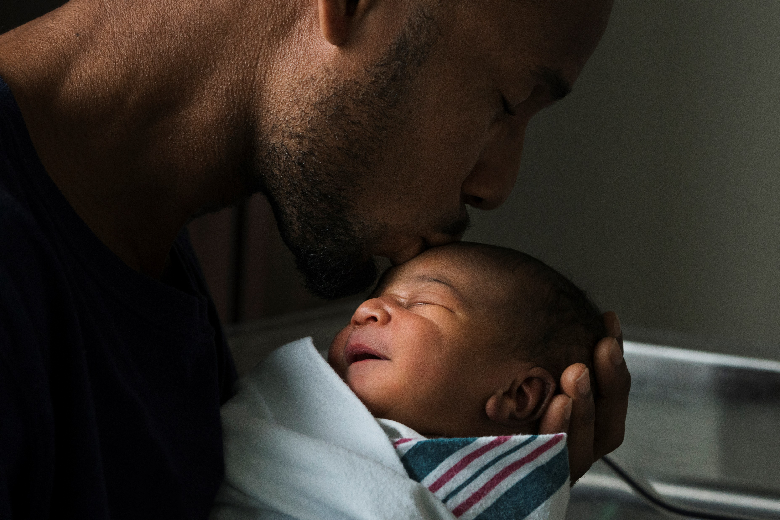
Routines
What do you think routine means?
Why are routines important?
Helps your child with their 'body clock'
Closer family unit
Establishes expectations
Creates a calmer household
Gives your child confidence and independence
Establishes healthy, constructive habits
Offers stability during times of change or stress

Slide 22

Setting Daily Routines
Think about important daily routines such as, getting up, playtime, eating,
bedtime & sleeping. Write them down and maybe create a chart with your child..
2. Be patient as routines can be difficult at first, eventually they will become regular to your child.
3. Add helpful elements to the routine eg: 10 minutes of reading time before bed to help them wind down.
4. For routines to work try to stick to them as much as you can but being flexible with them during holidays.
5. Create special time with your child in their daily routine.
6. As you start to get used to the routines you have created you will see what is working and what is not so adjust to your family's needs.

Slide 23
Websites
Morning routines:
https://www.bbc.co.uk/cbeebies/radio/poem-morning-routine
Bedtime routines:
https://www.bbc.co.uk/cbeebies/grownups/sleep-problems-in-older-children
Daily/Weekly routine:
https://www.highspeedtraining.co.uk/hub/the-importance-of-routine-for-children/
Apps: - Headspace, Calm, Relaxed Melodies, Sleep cycle, plus many more. (lots of free resources)

Slide 24
Challenge Time & Feedback
We are now going to challenge you to put this information into practice with your family. Let’s see if it makes a difference?
Think about:
What was helpful?
What did you find most useful?
Was it realistic for you?
Would you feel comfortable explaining these ideas to someone else?
Any challenges?

Slide 25
The Family Pack Lifestyle
Welcome
This is an informal information session that has been developed to help explore and better understand the following subjects:
Sleep
Healthy Eating
Routines
School Readiness
Sibling Rivalry
We understand that we all parent in slightly different ways, and what one parent does may not work for the other. You need to do what you feel may work best for you and your family. We hope the information in these sessions will be helpful”

Slide 26

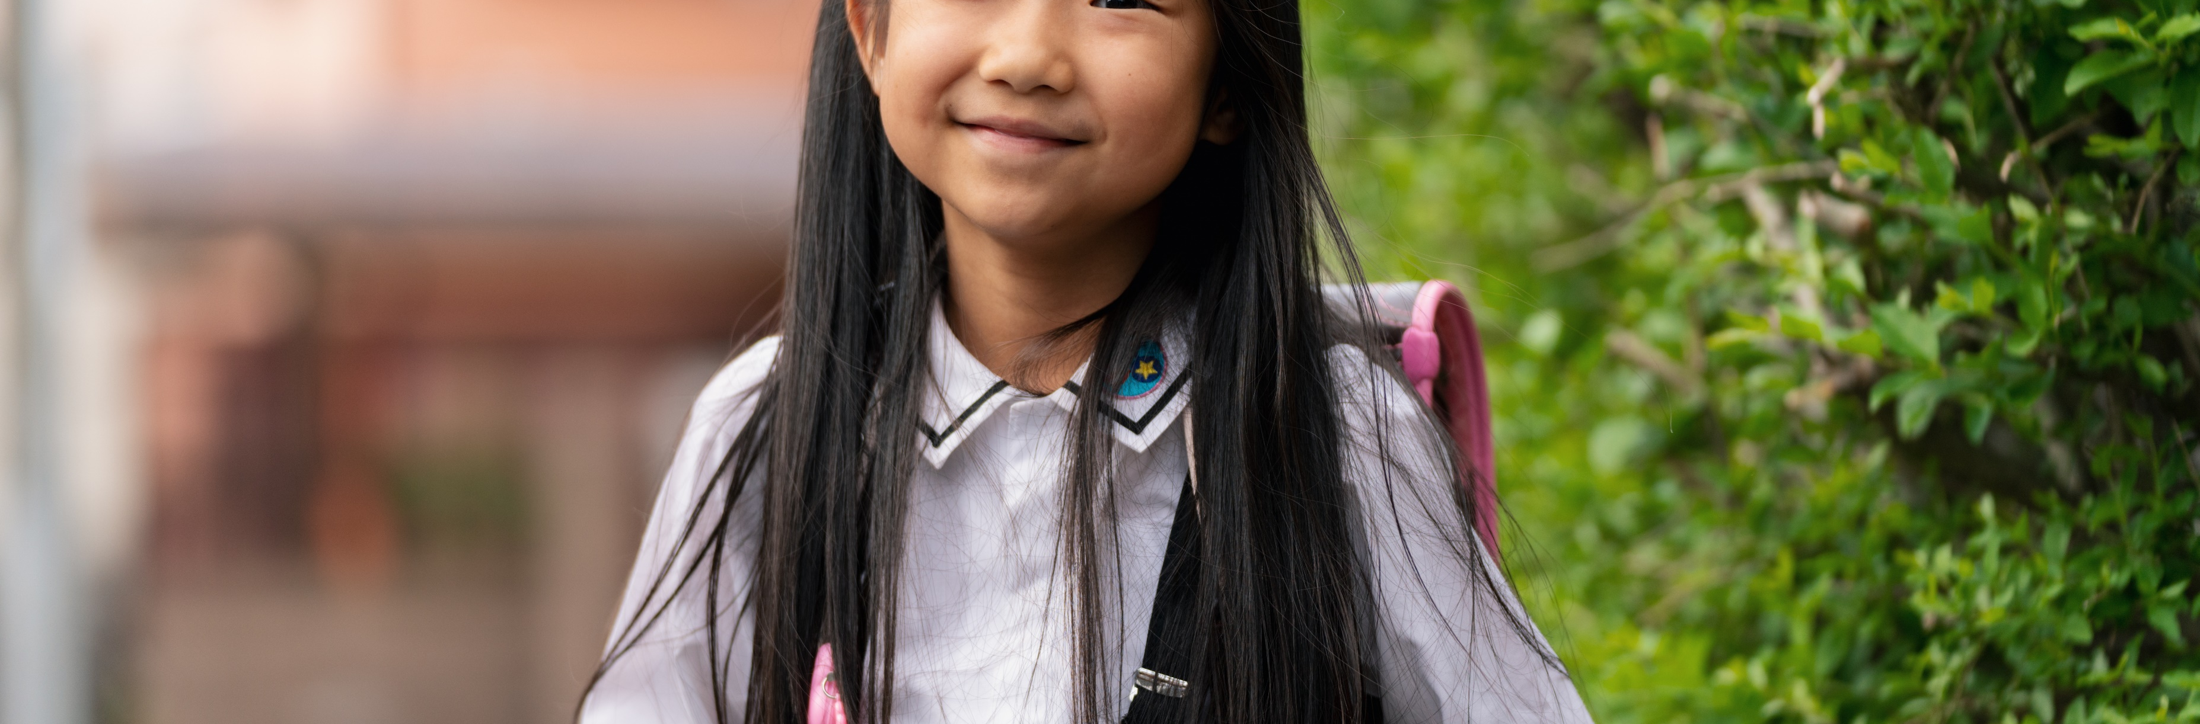
School Readiness

Slide 27

School Readiness
What does school Readiness mean to you?
Here are some common ideas:
A curiosity to learn
Relatively independent with their own personal care
Wanting to go to school
And are you ready to let them go….
Definition:
School Readiness" is a term often used to describe how ready children are socially, physically, and intellectually, to start school”

Slide 28
What does School readiness look like?
Some of the Characteristics that we look for before a child is ready for Primary school is;
Independent in toileting
Able to dress themselves
Understands expected levels of behaviour
Confidence and self-esteem
Can take turns and share
Can sit still for a short period
Can separate from parents/carers
Communication and language skills needed to communicate needs and listen to others
Can actively learn and creatively and critically think

Slide 29

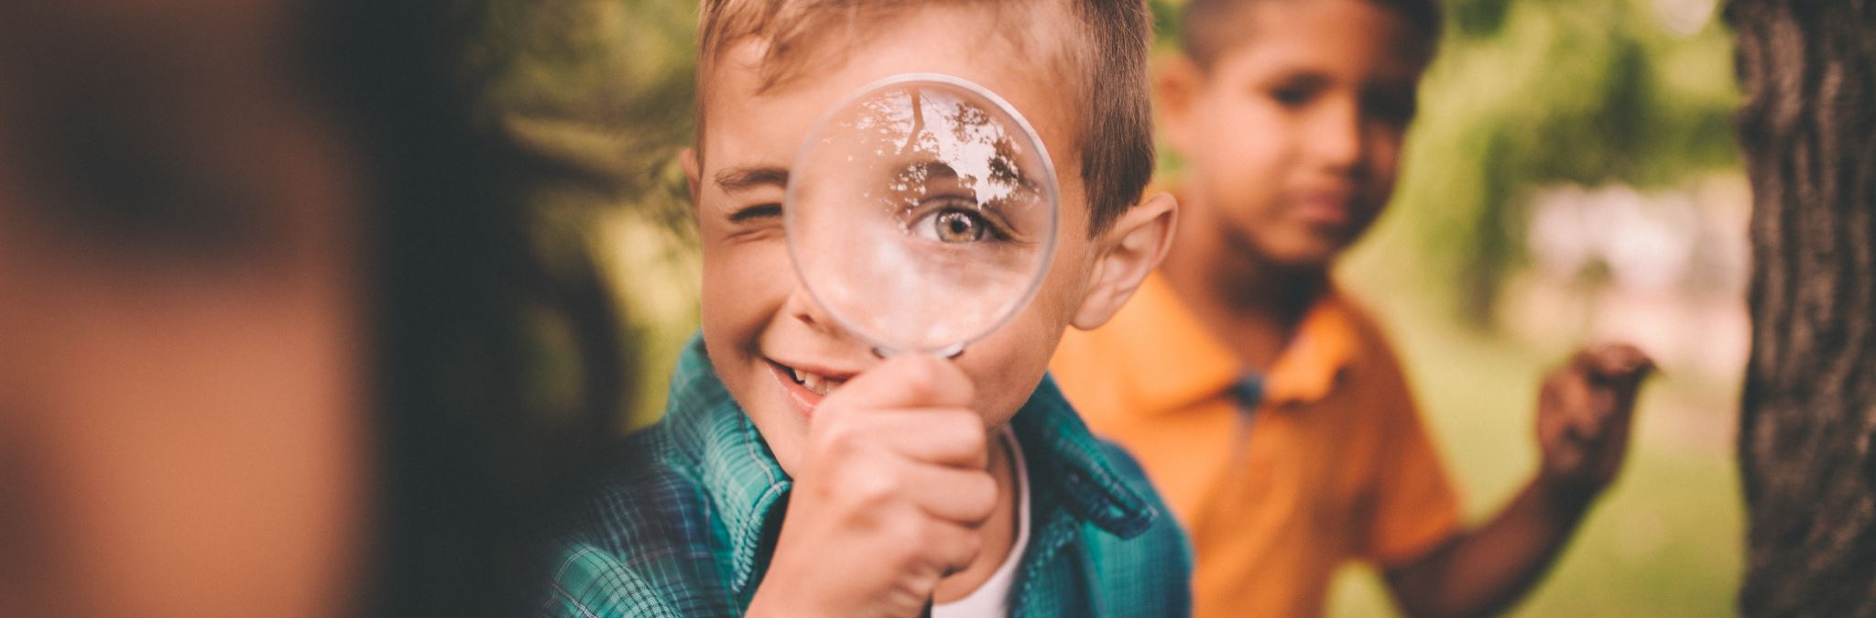
Some of the Characteristics we may notice when a child is ready for Secondary school is;
Starting to become more independent
Looking towards their future goals
Wanting to socialise more
Outgrowing activities they used to enjoy and changing their interests

Slide 30
What if my child is suffering from separation anxiety?
It's common for most children to experience some separation anxiety, but what can we do to help?
Avoid overscheduling. Focus on playtime, downtime, and healthy sleep habits
Make a plan to help your child transition to school in the morning (arrive early, act as the teacher’s helper before the other kids arrive, get some exercise on the playground before the bell rings)
Help your child reframe anxious thoughts by coming up with a list of positive thoughts (it even helps to write these on cards and put them in the backpack)
Alert your child to changes in routine ahead of time
Empathize with your child and comment on progress made – Keep your cool - Try not to disregard your child's feelings. - they may be hard for, us as adults to understand, but for children they are really important feelings and hard for them to process and control.

Slide 31
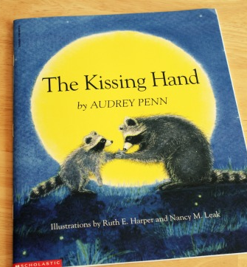
Resources
There is a book and an activity that I use with some of the children I work with to understand separation Anxiety.
The Kissing Hand – if you type this on youtube you can read it for free
Activity- We then design a 'Kissing hands necklace'
Cut out 2 hands and design them, one for parent and one for child.
Laminate them
Attach some ribbon and wear as a necklace, it can be kept safe under school top.
As in the book, kiss each hand before leaving each other.

Slide 32
Handouts
School Readiness:
https://www.pacey.org.uk/working-in-childcare/spotlight-on/being-school-ready/?gclid=EAIaIQobChMIj-aqjNy57wIVs2DmCh28uQ5uEAAYASAAEgIaAfD_BwE
The Kissing Hand:
https://www.youtube.com/watch?v=0URlsHiPy10
Preparing your child for school:
https://www.childcare.co.uk/information/school-readiness
NHS Checklist:
https://www.buckshealthcare.nhs.uk/Downloads/CYP%20school%20nursing/CYP%20SN_2020/School%20Readiness%20Checklist%20-%20V5.pdf
Getting your child for school:
https://www.savethechildren.org.uk/blogs/2018/mind-the-gap-getting-our-children-ready-for-school?

Slide 33
Challenge Time & Feedback
We are now going to challenge you to put this information into practice with your family. Let’s see if it makes a difference?
Think about:
What was helpful?
What did you find most useful?
Was it realistic for you?
Would you feel comfortable explaining these ideas to someone else?
Any challenges?

Slide 34
The Family Pack Lifestyle
Welcome
This is an informal information session that has been developed to help explore and better understand the following subjects:
Sleep
Healthy Eating
Routines
School Readiness
Sibling Rivalry
We understand that we all parent in slightly different ways, and what one parent does may not work for the other. You need to do what you feel may work best for you and your family. We hope the information in these sessions will be helpful”

Slide 35

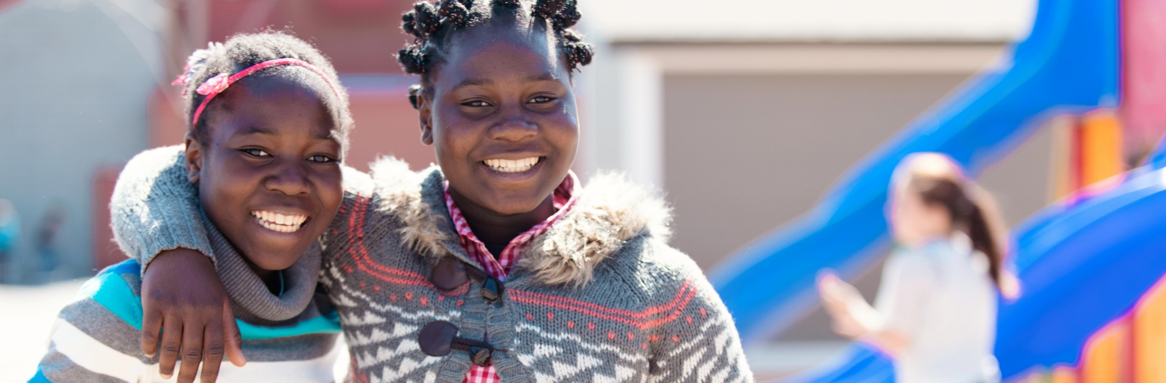
Sibling Rivalry

Slide 36

Sibling Rivalry
What is it and what might it look like?
If there is more than one child in the home, sibling rivalry is often inevitable. The challenge for parents’ is managing siblings fighting, bickering & teasing. Which can leave parents/carers feeling exhausted and worn out.
It is a concern for almost all parents of two or more children. Problems can start right after the birth of the second child.
What happens in your house?
https://centerforparentingeducation.org

Slide 37
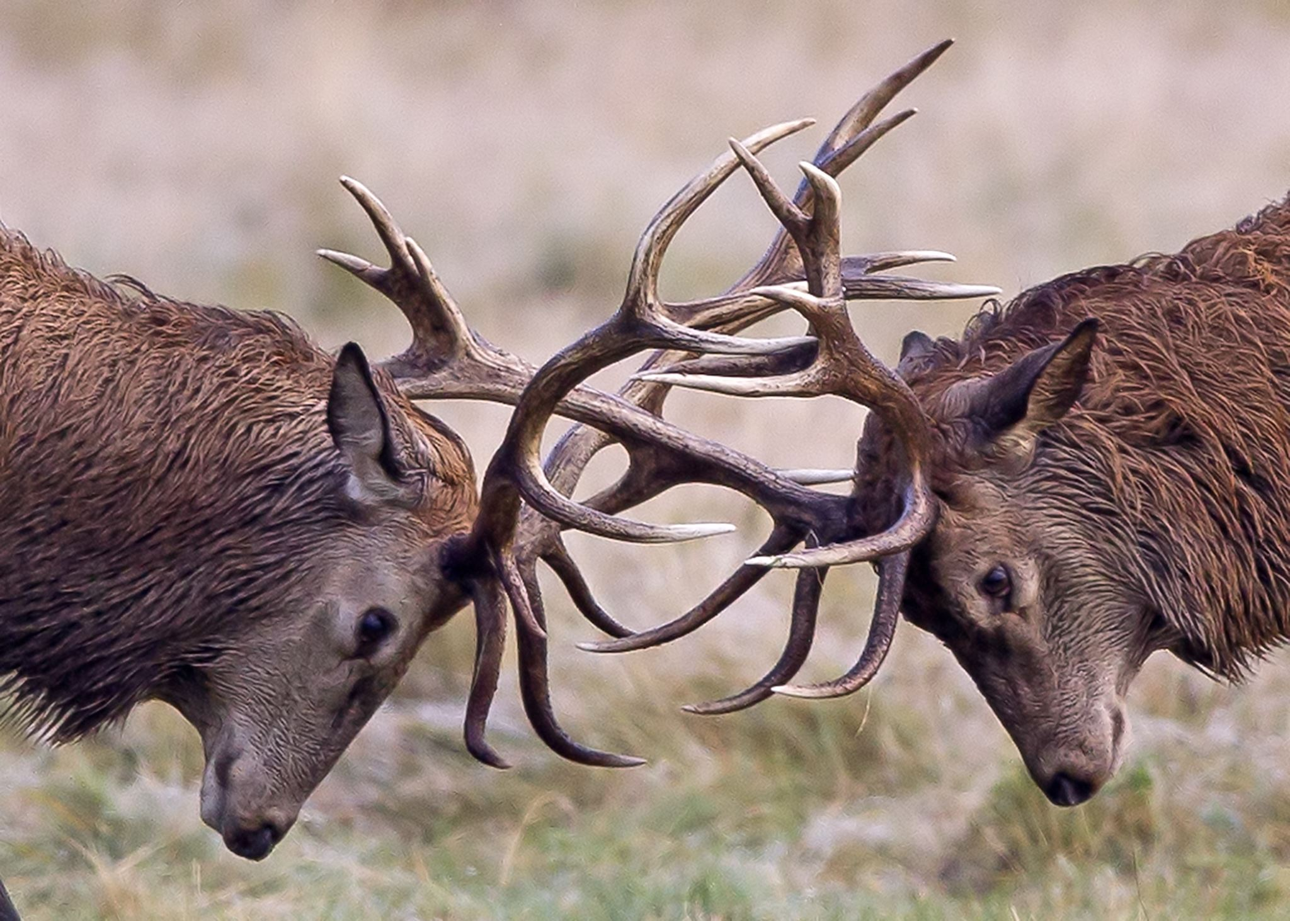
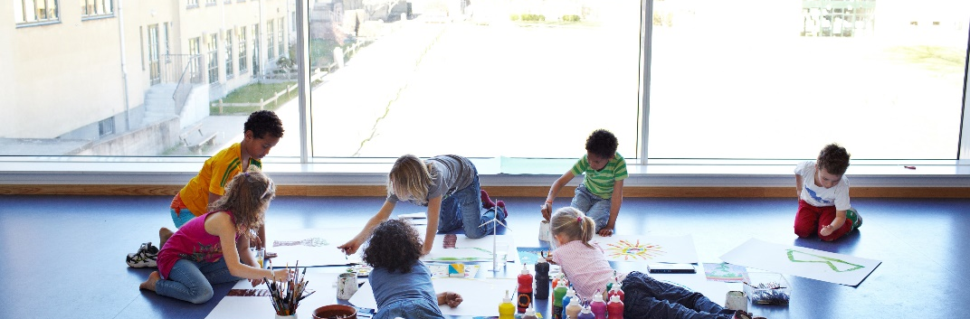
Competing Siblings?
Why might siblings compete?
Attention seeking
Wanting physical contact (Cuddles, holding hands etc)
Annoying a sibling may seem more exciting than anything else going on because they are bored
Unable to connect with their sibling (ignoring or reacting to them)
Power struggle, wanting to be in charge.
Becoming ‘the favourite’
We need to help them to understand that fighting with a sibling is not acceptable. We can help and guide them to have a more positive relationship with their siblings.

Slide 38
Factors that can influence sibling rivalry
Being aware of these may help.
Birth order
Children that are close in age
Understanding your children’s different characters
Gender
Family dynamics (Step-children, extended families)
The age of the children (larger age gaps)
Being aware of the factors that influence sibling rivalry can help you to be more understanding and support you to respond in sensitive ways to the sibling issues that arise.
https://centerforparentingeducation.org

Slide 39

What can you do?
Tips to help prevent sibling rivalry?
Recognise your child's needs... (see them as individuals)
Set clear family rules... (clear expectations)
Good routines…
Praise them often… (acknowledge positive behaviour)
Been a good role model… (Children learn from the adult around them)
Recognise when your child might need some time out
Let children work it out sometimes… (just listen)

Slide 40
Handouts
Coping with sibling rivalry:
https://centerforparentingeducation.org/library-of-articles/sibling-rivalry/coping-sibling-rivalry/
How to stop siblings fighting:
https://www.sitters.co.uk/blog/how-to-stop-siblings-fighting.aspx
Helpful tips:
https://raisingchildren.net.au/school-age/behaviour/friends-siblings/preventing-fights#6-coach-your-children-nav-title
Teenagers:
https://raisingchildren.net.au/pre-teens/behaviour/sibling-fights/sibling-fighting
Sibling rivalry remedies:
https://www.supernanny.co.uk/Advice/-/Family-Matters/-/Relationships/Sibling-rivalry-remedies.aspx
Book idea:
Siblings you’re stuck with each other, so stick together – James J. Crist &Elizabeth Verdick
https://www.amazon.co.uk/Siblings-Youre-Together-Spirit-Publishing/dp/1575423367/ref=sr_1_1?dchild=1&keywords=siblings+youre+stuck+with+each+other%27&qid=1617010827&sr=8-1

Slide 41
Challenge Time & Feedback
We are now going to challenge you to put this information into practice with your family. Let’s see if it makes a difference?
Think about:
What was helpful?
What did you find most useful?
Was it realistic for you?
Would you feel comfortable explaining these ideas to someone else?
Any challenges?

